Slide 1
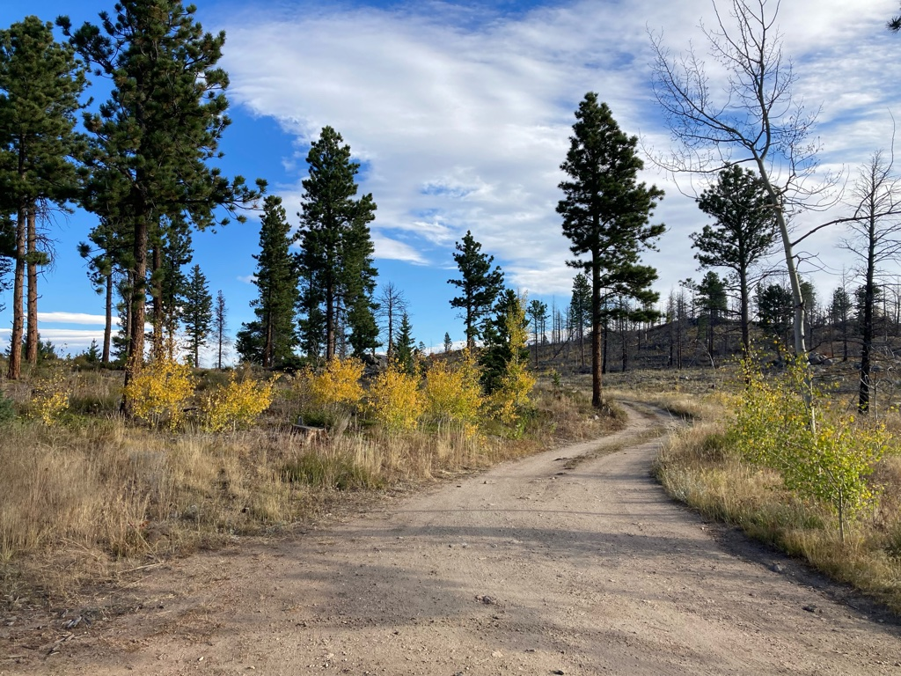
Site and microsite factors influence the survival and growth of tree seedlings planted after the Cold Springs wildfire
Laura A. E. Marshall
Postdoctoral Fellow
Forest and Rangeland Stewardship Department, Colorado State University
Paula J. Fornwalt, Camille S. Stevens-Rumann
Kyle C. Rodman, Charles C. Rhoades, Kevin Zimlinghaus
Teresa Chapman, Catherine A. Schloegel

Slide 2
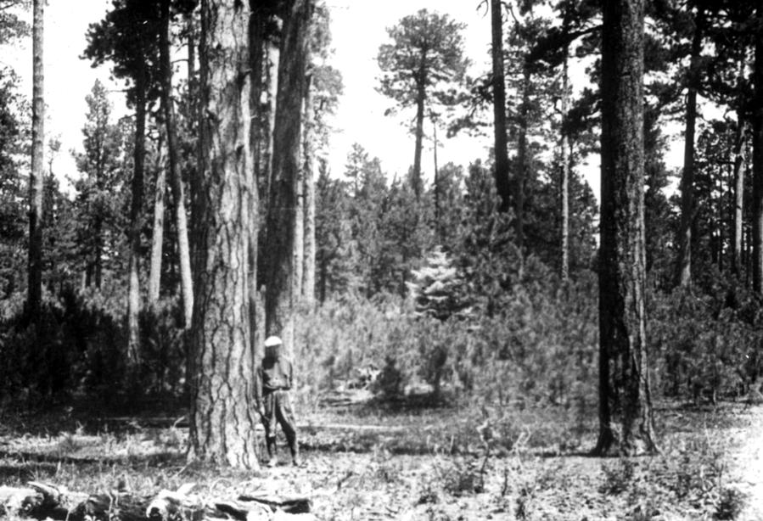
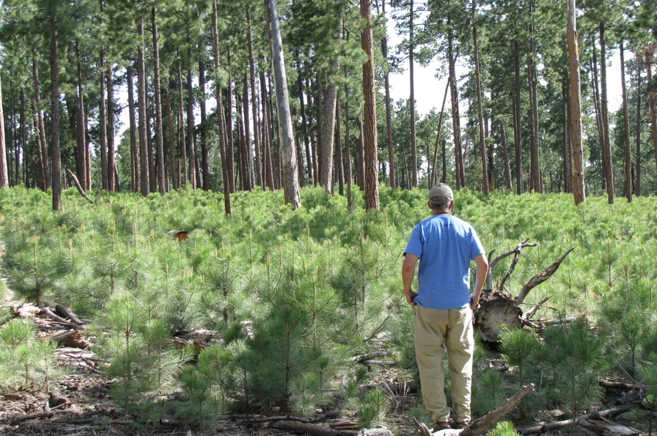
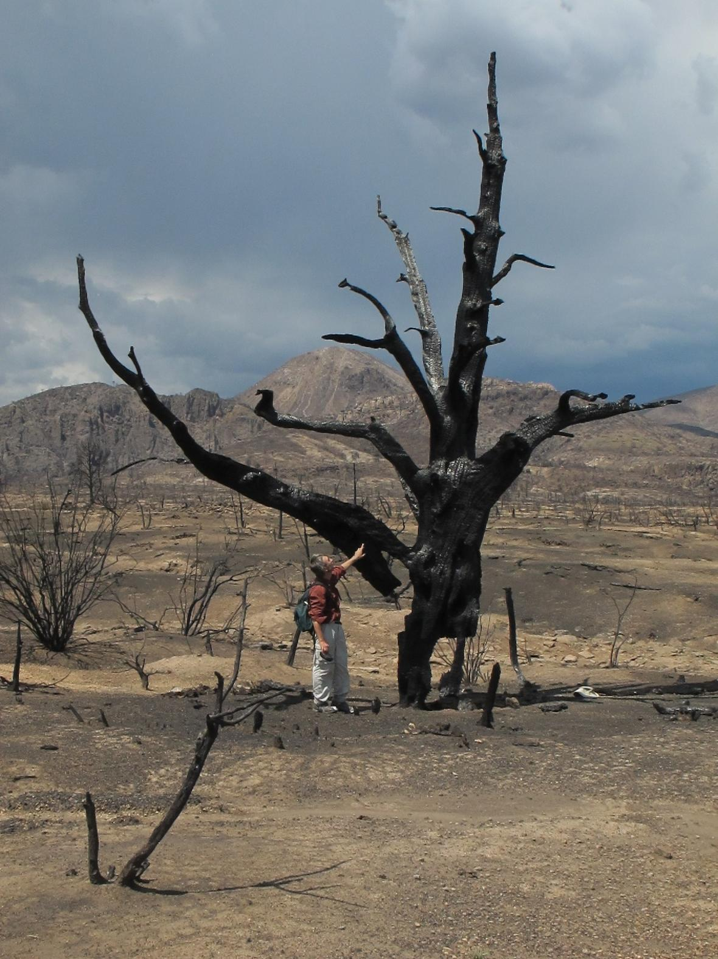
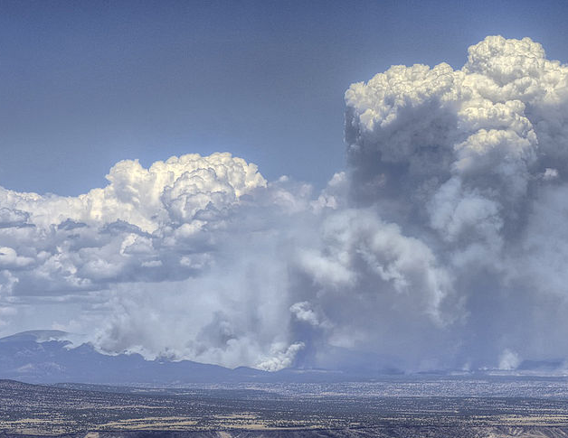
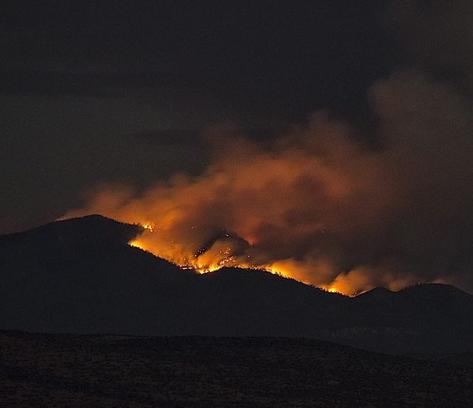
Jemez Mountains 1929, U Chicago
Jemez Mountains, 2012, post-thinning
Legacy of fire exclusion
+ extreme weather
= extreme fire and landscape scale change
Las Conchas Fire, John Fowler; Craig D. Allen USGS.
Notes:
Especially in montane frequent fire forests
And potential for vegetation type change following disturbance like a severe fire; can address by fuel treatment beforehand; and planting tree seedlings after

Slide 3
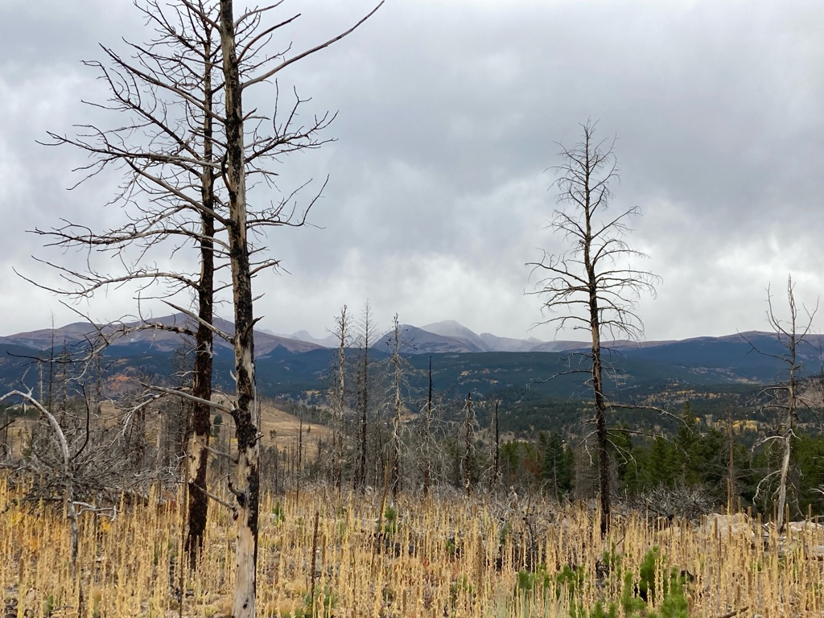
Post-fire forests: Potential for vegetation type conversion
Seedling establishment in severely burned areas:
Natural regeneration; Planting
Increasing extreme fire behavior and size
2020 fires added to backlog of needed planting
REPLANT act increasing pace of planting
Monitoring needed to ensure success
Chapman TB, Schoennagel T, Veblen TT, Rodman KC (2020) Still standing: Recent patterns of post-fire conifer refugia in ponderosa pine-dominated forests of the Colorado Front Range. PLoS ONE 15(1): e0226926.
Notes:
*more knowledge about drivers of natural regeneration than planting success; this work addresses some of those limits
38% of the burned area was ≥ 50m from a conifer seed source, revealing a management challenge as fire sizes increase with warming further limiting conifer recovery.

Slide 4
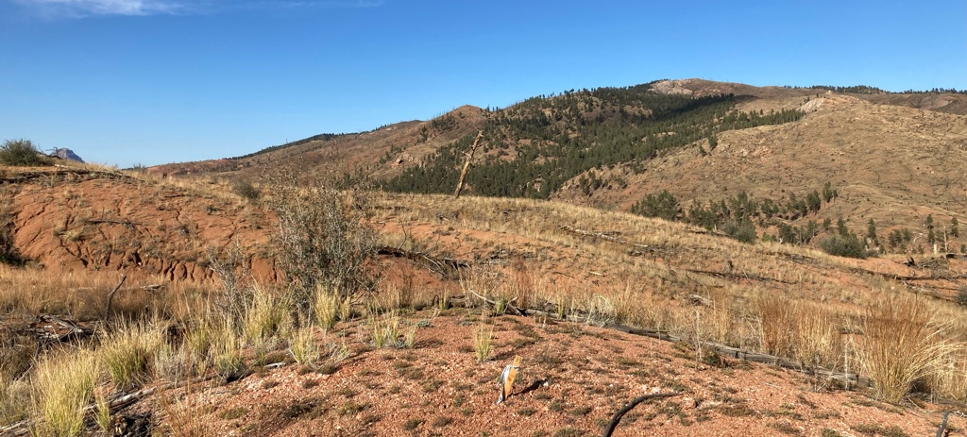
Planting for Restoration
Tree planting:
Important tool to nudge the trajectory of post-fire landscapes towards desired conditions
Particularly in areas where seed source is limited

Slide 5
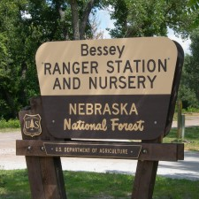
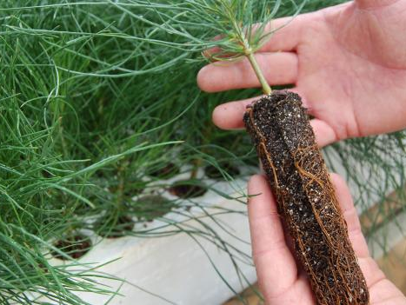
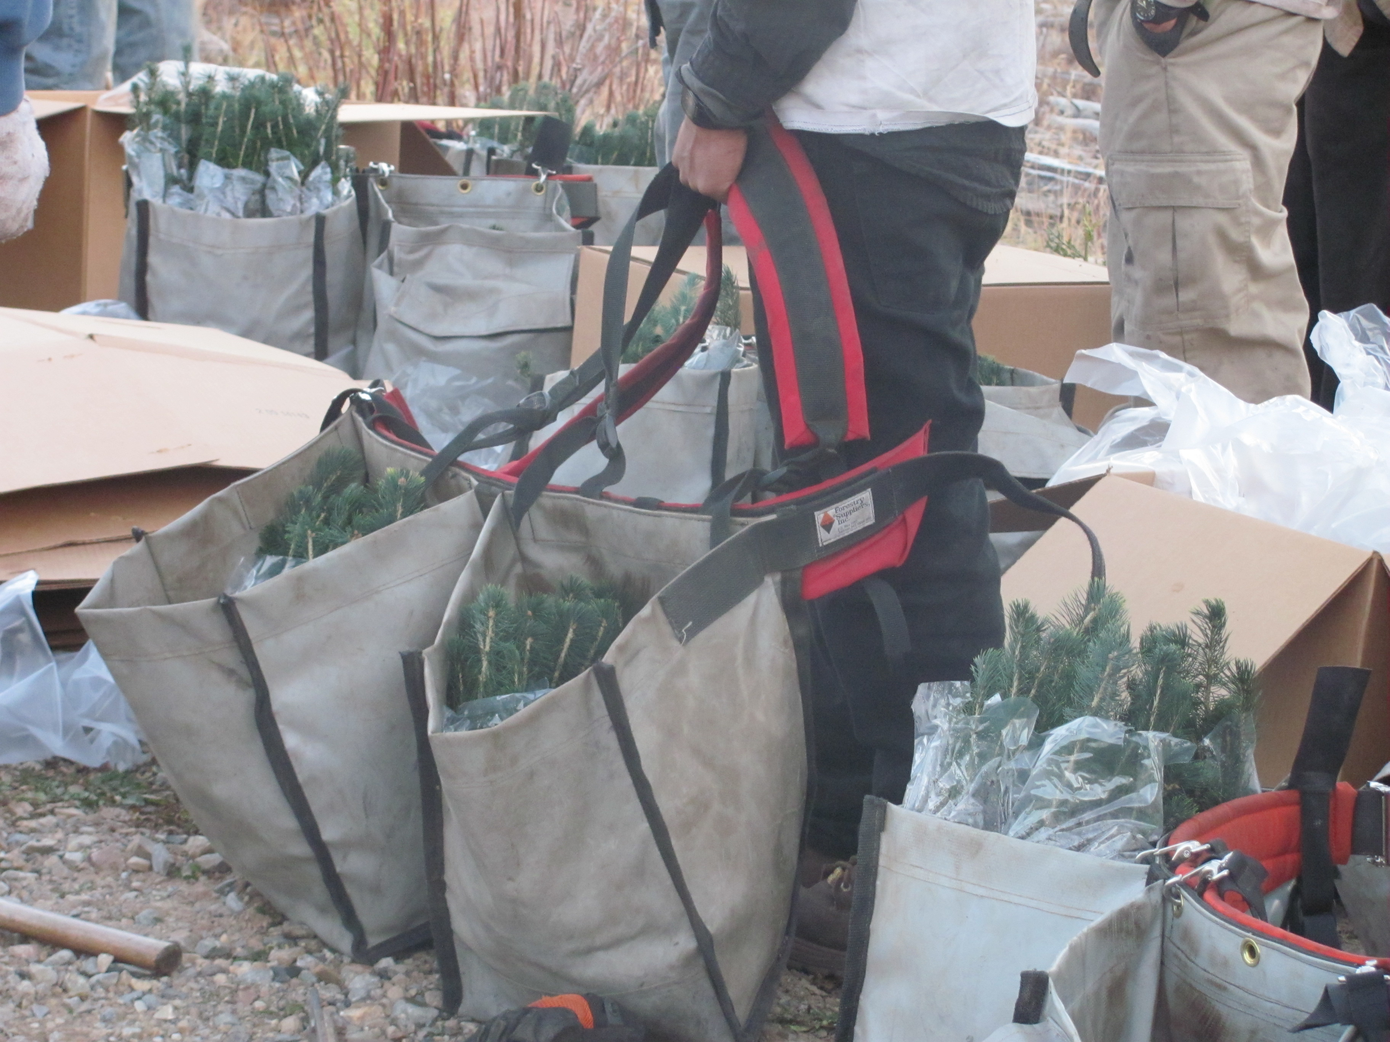
Typically nursery grown 1-yr seedlings from collected local seed
Transported in refrigerated trucks to the planting site
Planted out to project specifications
Tree density
Site prep
Stake row setup for monitoring
Notes:
How does planting work? Cones drying – bessey – delivery conditions

Slide 6
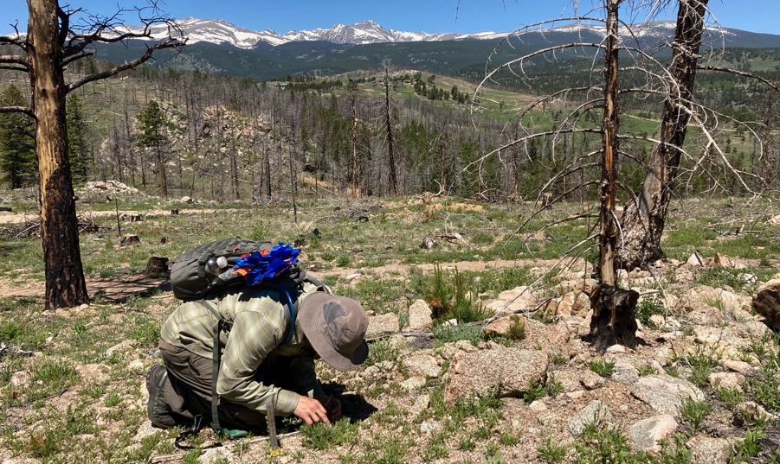
Cold Springs Fire: July 2016
Nederland, CO
528 acres
Upper montane forest
Severity
8 homes lost, human caused
92 acres planted in 2018
Notes:
Not necessarily outside HRV, nearby seed source, but still planted
Stake rows for monitoring

Slide 7
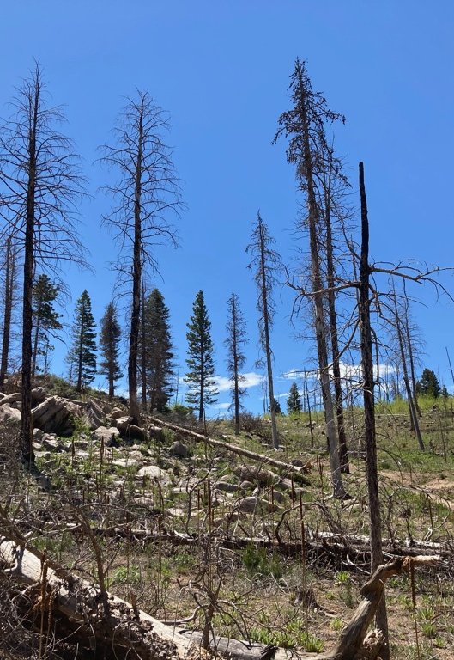
Important Factors
Planted in 2018, 92 acres
Multiple species planted
Ponderosa, limber, Douglas-fir
Present on site before fire
Likely to survive in future
Unlikely to regenerate naturally
Plentiful lodgepole regen
Planted by volunteers
Many stake rows placed (300 trees)
Seed source
Within NF
From similar elevation/site
Notes:
Note serotinous cones; spp planted to promote seed-obligate conifers that may do well in future climate;
Limber pine (PIFL), 21/Acre, Ponderosa pine (PIPO), 98/Acre, Douglas fir (PSME), 3/Acre

Slide 8
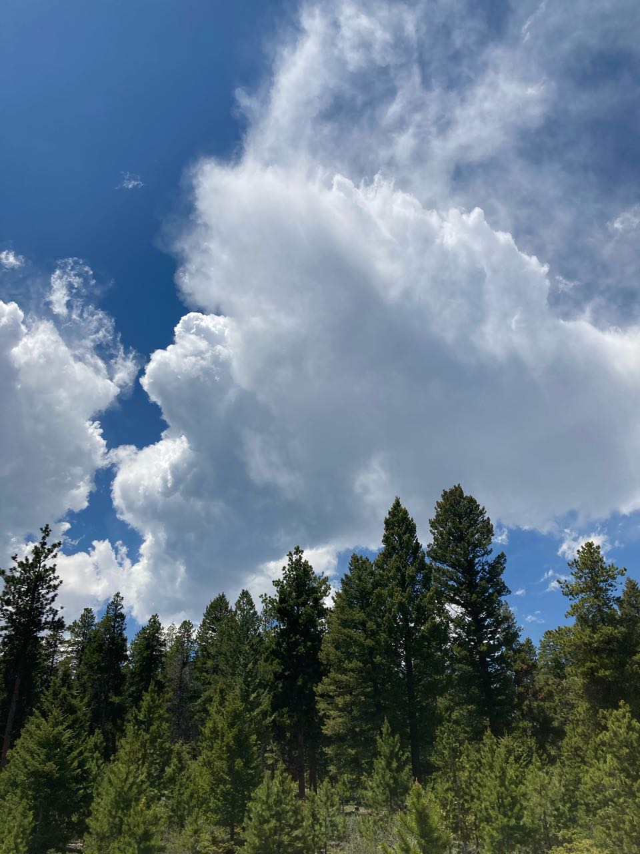
What site and microsite factors promote seedling survival?
Site: similar across large area
Identify suitable planting units
Aspect, elevation, slope
Climate
Microsite: affect microclimate
Individual seedling placement
Shade objects: log, stump, snag, rock
Shade roots of seedling ~2pm
Depression
Water would collect at seedling
Notes:
So here we come to the question this research addresses

Slide 9
Response
At 4 growing seasons after planting:
Survival
Seedlings live or dead
Height
Total seedling height
Height Growth
Height increase in 2021

Slide 10
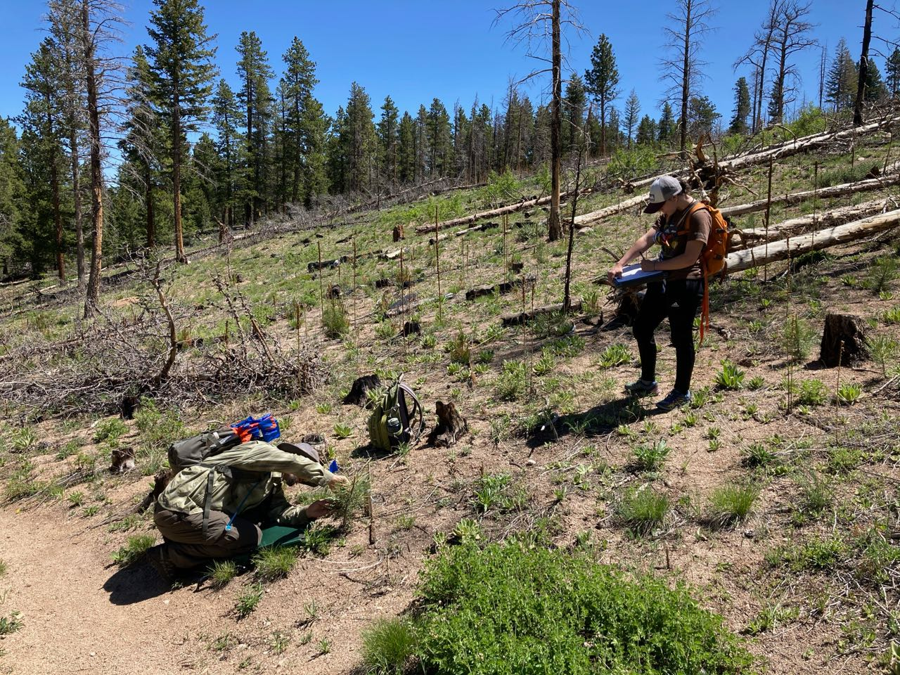
Field work in Summer and Fall 2021:
Collected survival, growth, microsite, and site information at all stake rows
Plus 3 seasons survival data from ARNF
Sampled soil moisture at ponderosa seedlings over summer
Examined importance of factors using GLMM: generalized linear mixed model
Notes:
Spatial analysis in qgis, statistical analysis in R

Slide 11
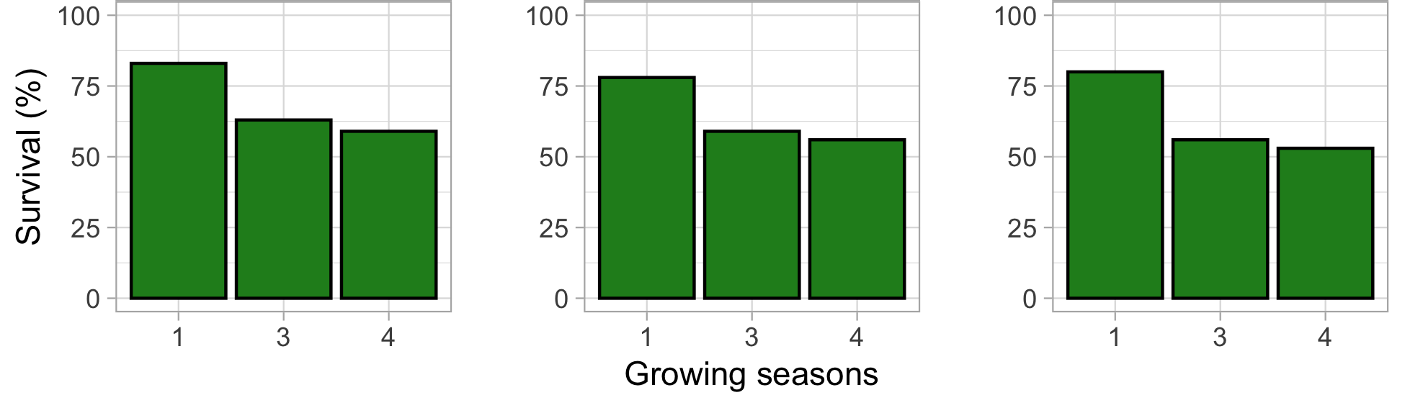
Survival by species over time across all stake rows
Ponderosa pine
Limber pine
Douglas-fir
Notes:
Pretty typical of stake row survival in Colorado montane plantings

Slide 12
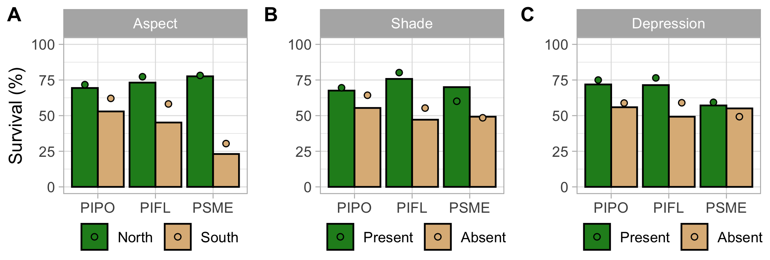
Survival
*Aspect
*Shade
*Depression
North aspect, in shade, in depression
Site and microsite factors investigated were significant for survival
No species interaction seen
(generalized linear mixed model, stake row as random effect)
Notes:
Dots = predicted values from the model

Slide 13
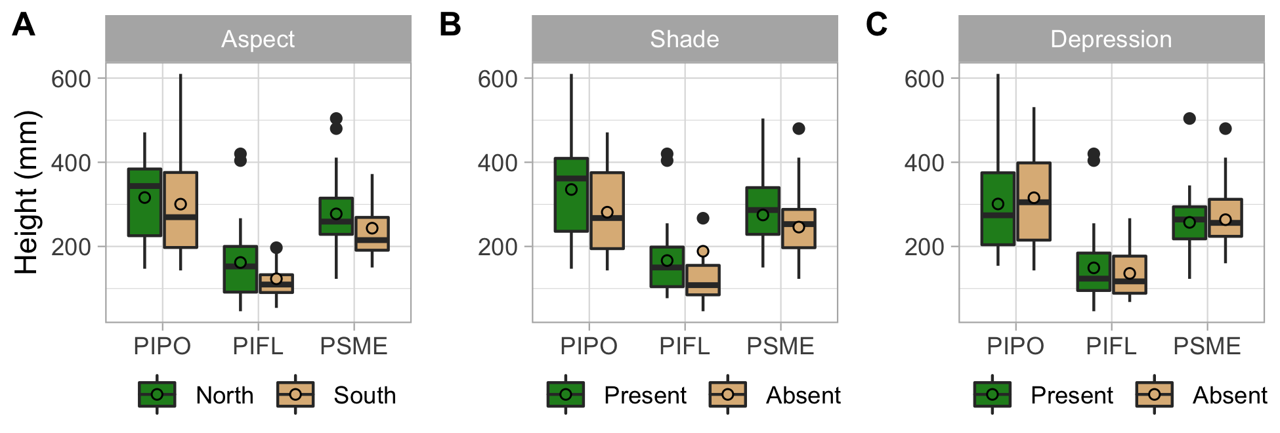
Height
*Aspect
*Shade
Depression
North aspect, in shade, species
Some site/microsite factors important, species significant
Different species likely had different heights at planting due to growth habit
(generalized linear mixed model, stake row as random effect)

Slide 14
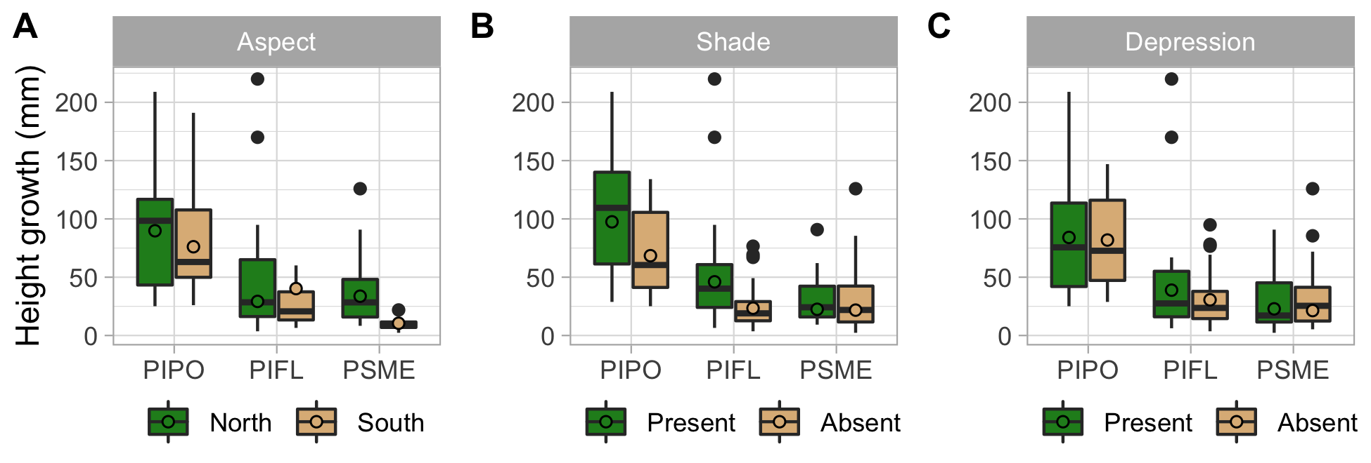
Height Growth
*Aspect
*Shade
Depression
North aspect, in shade, species, species interaction with aspect and shade
Some site/microsite factors important, species important & interacts with other factors
Height growth may reflect conditions and changes since planting, plus species growth habit
(generalized linear mixed model, stake row as random effect)

Slide 15
Soil Moisture
Aspect
Shade
*Depression
Depression had only significant difference in soil moisture
Sampled % soil water content at ponderosa seedlings on two days
Little precipitation during that period could have driven NS results: could have been too dry to see a difference
(generalized linear mixed model, stake row as random effect)
Notes:
Examined as a potential mechanism driving differences in survival/growth across microsites; sig for survival

Slide 16
Conclusions
All Species
Greater survival on north aspects, with shade, with depression
Greater height & growth with north aspect and shade
90% survival for north+shade+depression
31% for south+exposed+no depression
By Species: project not designed to test, but
Traits are potentially important
Douglas-fir: More moisture sensitive species
Aspect had substantial effect on survival
Notes:
Not a global model, note that factors are more/less important
Veg cover, soil moisture, ecophys results
What is veg cover? Productivity, competition, etc and is dynamic, affects shading?

Slide 17
Conclusions
History of fire exclusion causes problems in frequent-fire forests
2020 fires add to a backlog of area needing planting to maintain desired forest conditions
Microsite & site planting choices are important for seedlings
More success in more mesic sites (shade, north aspect, depression)
Need to know more, to give planted seedlings best chance of survival: How can we do better?
Notes:
Eventually post-fire management becomes pre-fire management, potentially tied into a larger landscape management plan

Slide 18
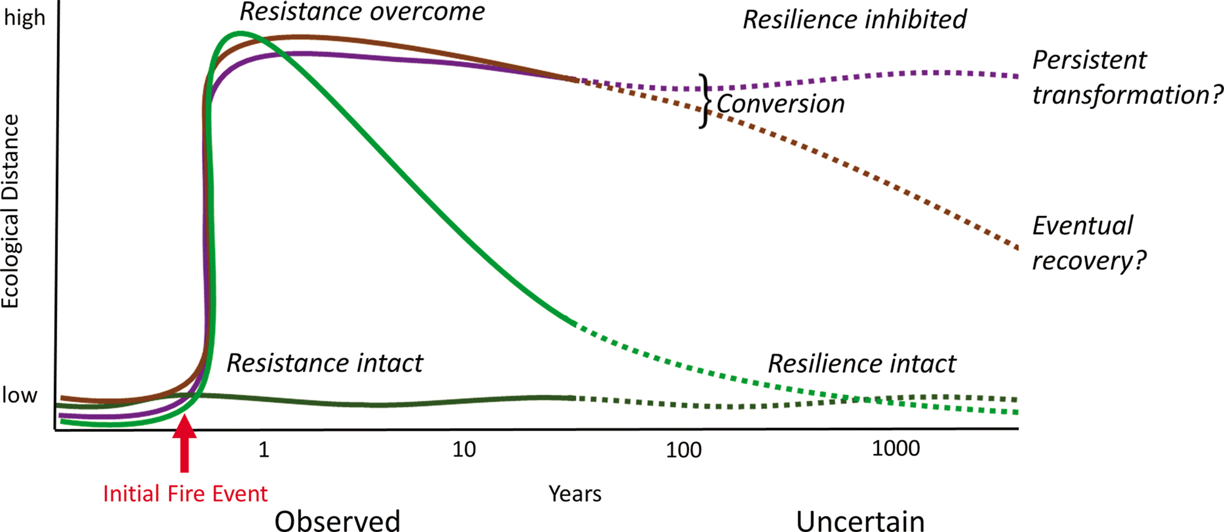
What happens after fire?
Post-fire forest recovery trajectories: Potential for vegetation type conversion
Resistance: avoid change
Resilience: return to previous state after a change
Restoration
Notes:
Restoration, specifically tree planting, can potentially alter the trajectory of a landscape after a severe disturbance
Figure 2. Hypothetical ecological outcomes of fire. The x-axis represents time since the initial fire; the y-axis represents ecological (e.g., compositional) dissimilarity relative to the prefire state. A low value indicates little change, and a high value indicates substantial change, such as a shift from dominance by one species or functional group to another. A forest stand with high resistance may be essentially unchanged following a fire—for example, when a surface fire burns through a ponderosa pine (Pinus ponderosa) forest. When resistance is overcome, a resilient system may change substantially, but still return toward its predisturbance state over time—for example, tree regeneration from seed following high-severity fire in a high-elevation lodgepole pine (Pinus contorta) forest. When resilience processes are overwhelmed, recovery toward a predisturbance state may be severely protracted or entirely precluded. Conversion refers to this condition. However, studies of recent postfire dynamics are limited to only a few decades postfire, represented by the solid lines; the time scales of these processes are highly uncertain. The dashed lines represent possible but uncertain future trajectories that cannot be known because of changes in climate, fire regimes, and society.

Slide 19
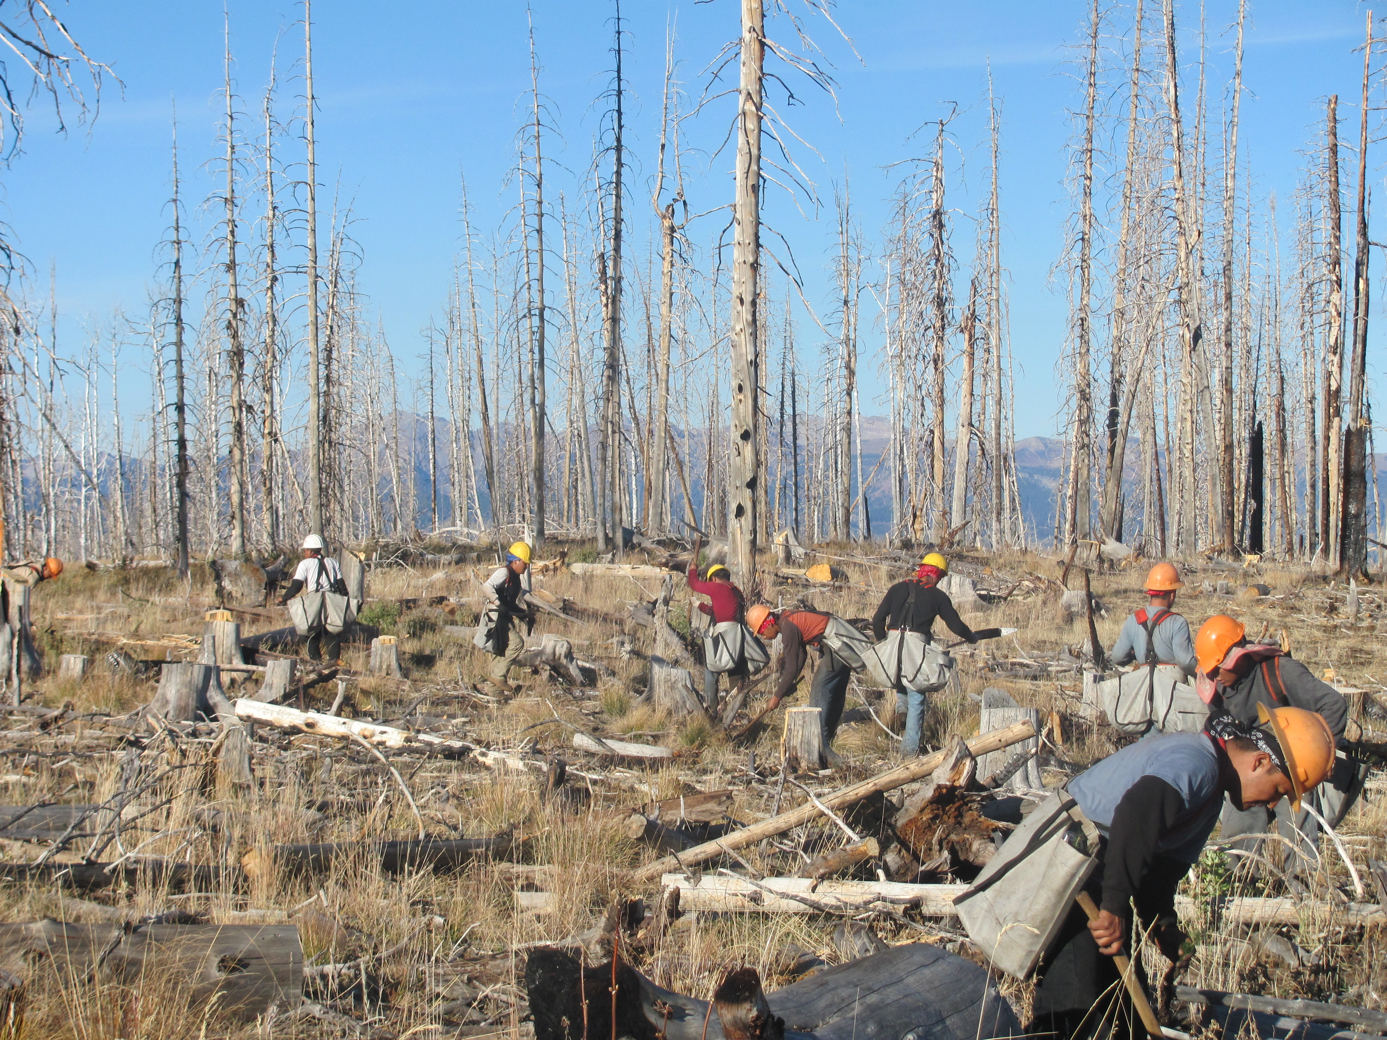
Notes:
Planting in the san juans with a professional crew and site prep (cutting)
Site prep (likely salvage logging here), clearing soil around planted seedling, shelters and microsite planting; San Juan NF; contract planting crews, volunteers, or both

Slide 20
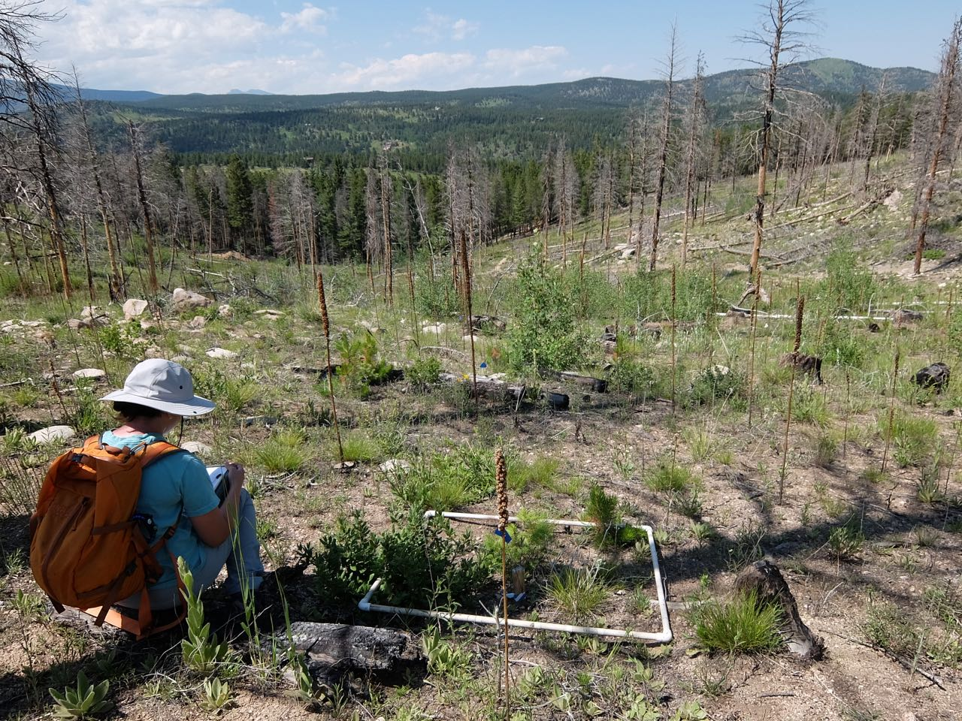
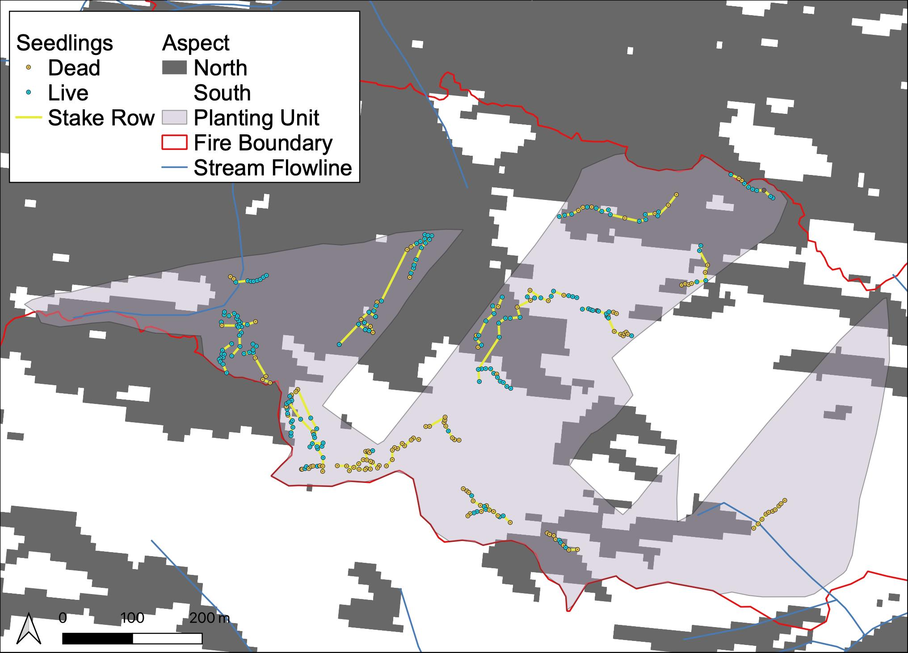
Site: Aspect
Notes:
(also slope, don’t have microclimate at resolution of stake row so aspect is proxy for that/moisture availability)

Slide 21
Microsite
Shade
Change
Shade
Log
Snag
Stump
Exposed
Open
Change
Snag fall
Cutting
Depression
Present
Exposed
Depression
Notes:
Photo examples of factors
Shade: open, log/snag/stump

Slide 22
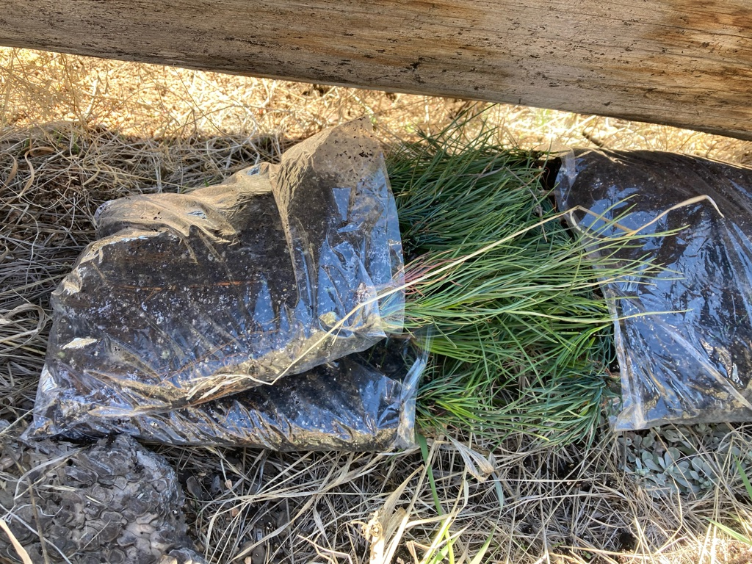
Post-fire Planting
Other factors (not considered)
Seed source/seed lots
Within NF
From similar elevation/site
Availability, age of seed
Genetics
Nursery/Planting techniques
Differ across NFs, fires, years
Treatment of seedlings before planting
Notes:
Factors not considered

Slide 23
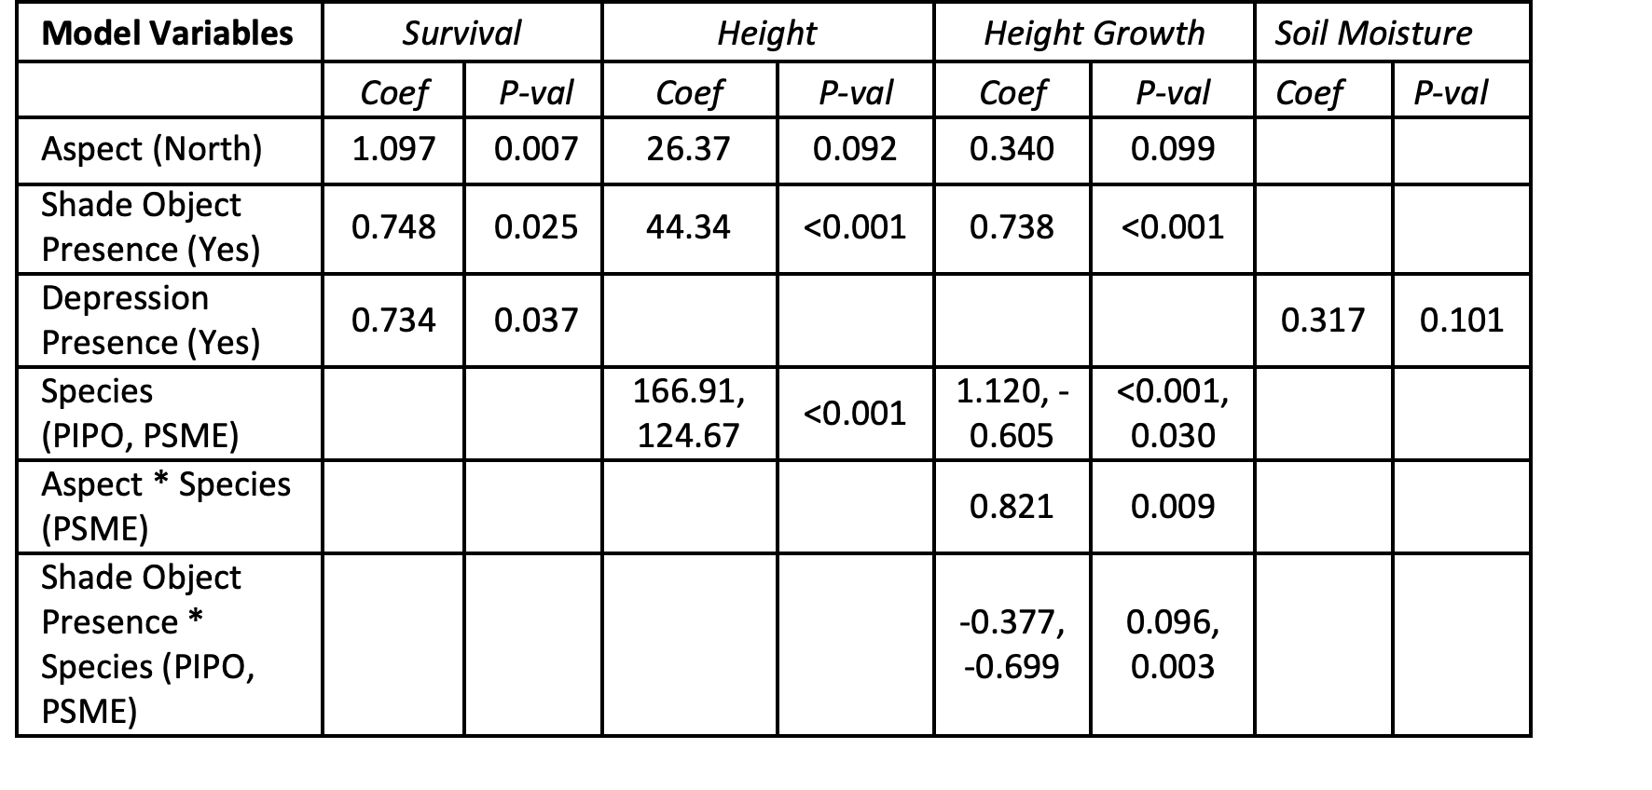
What is most important for each response variable?
Tested with GLMM model
(generalized linear mixed model, stake row as random effect)

