Slide 1

Limited Seed Viability in Gray Phase Lodgepole Pine
Chuck Rhoades – US Forest Service
Rocky Mountain Research Station
Collaborators
T. Fegel, M. Chambers, R. Hubbard, D. Tinker, T. Vorster

Slide 2
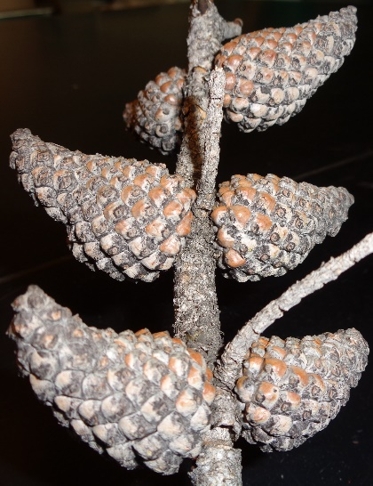
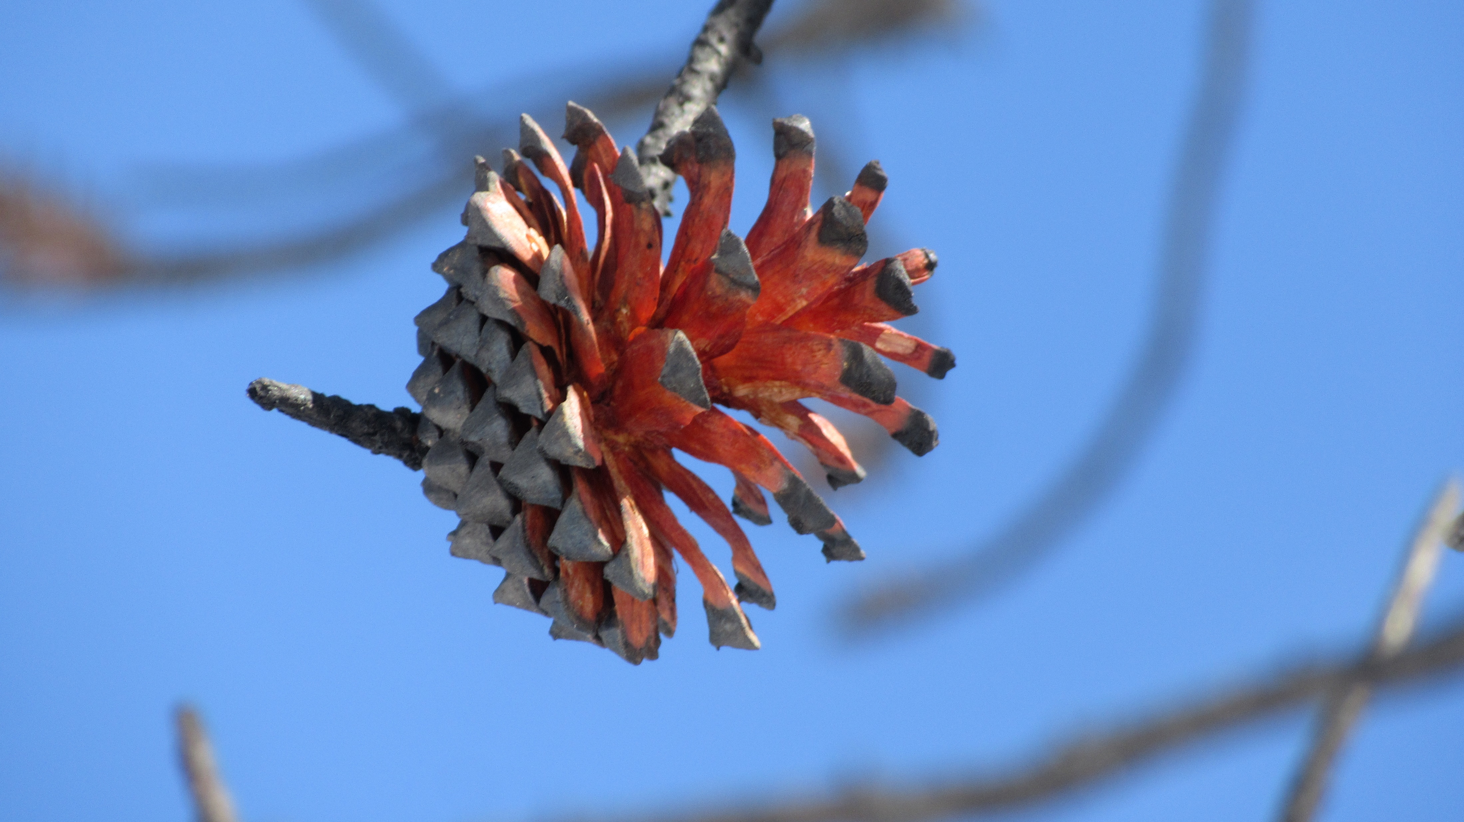
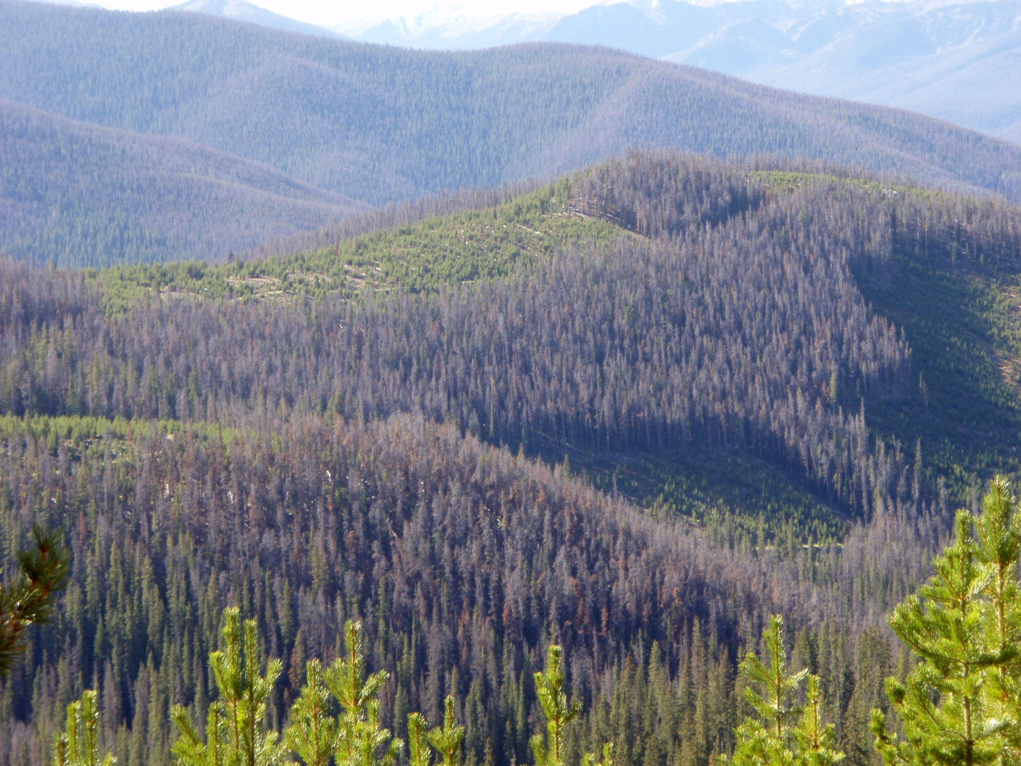
‘Silvical Notes on the Lodgepole Pine’
E.R. Hodson 1908
Lodgepole pine is a tree which is so much better equipped to reproduce itself under adverse conditions than its associates that it is natural to assume that abundant reproduction is certain follow any cutting or fire. It is believed by many that it will somehow take care of itself. A careful study of the actual conditions, however, leads to the conclusion that such a view is not warranted
Notes:
Need
NOAA overview
Stone BMP

Slide 3
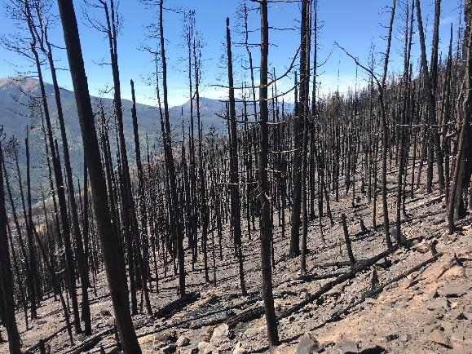
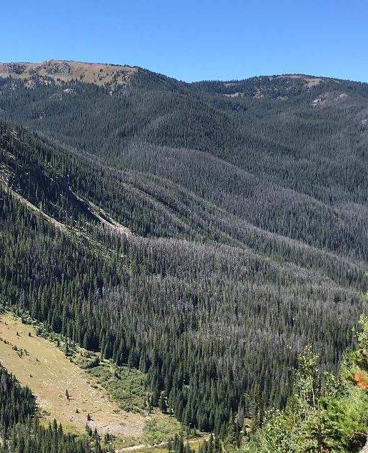
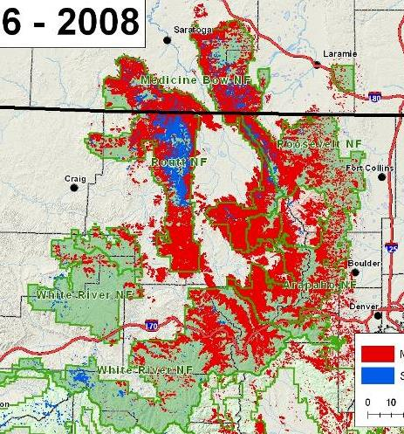
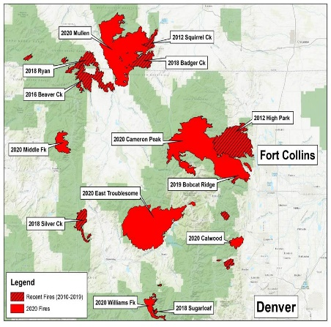
Compound Disturbance in Hi Elevation Watersheds
Bugs, then Fire in Lodgepole Forests
Gray Phase Fires Acres
2010-2019 150,000
2020 >600,000
Wildfire combined with drought, insects, wind or factors, may delay or prevent recovery of forests to expected or desired structure or composition.
Given projected increases in disturbances and climate stressors, occurrence of compound disturbances are expected to increase.
In the S. Rockies, LPP is at the southern extent of its range, even in the absence of disturbance is considered at mod to hi vulnerability to changing climate.
Bark Beetle
Extent
‘96-’08
Recent Fires
Notes:
Natural disturbance regimes maintain ecosystems
Climate-enhanced disturbances can shift things
Likely to increase since many disturbance are expected to expand and overlap
Post-MPB fire has been called ‘the new normal’ regarding wildfires in this area.
There is very little known and what is known depends on the unique features of both the individual and compound disturbance
There is evidence that things may be different from what might have been expected regarding regeneration (pace of recovery, density and possibly species composition).
Post disturbance patterns are always complex and highly variable and it’s way too early to say how much if any of the sky is falling.
With a species like LPP, lower density may be beneficial for numerous resources and reasons.

Slide 4
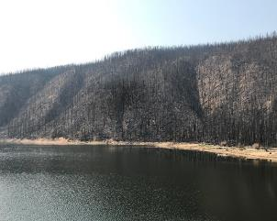
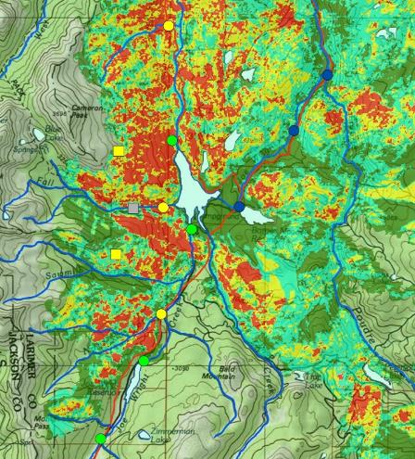
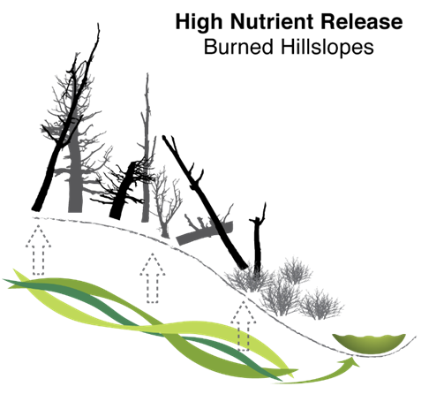
Headwater Forests Supply the West’s Water
75% of western US water supply originates as surface water in forest watersheds.
Post-fire erosion, nutrients, ash & other contaminants threaten drinking water, agricultural, aquatic habitat, & recreation
  Chambers lake After
  Cameron Pk Fire
“Forest fires of the western US have advanced upslope over the past few decades, scorching territories previously too wet to burn.”
Alizadeh et al. 2021, PNAS
Revegetation determines the duration of post-fire water quality degradation and the rate of watershed recovery.
Notes:
Source Water
Important Location
Poorly understood Fires - Long Return Intervals
Other Climate Related stress (Drought, Insects, N deposition)
Clean Water/Human Health
Expected output of Forest Watersheds
Eutrophication Nutrient Enrichment degrades Aquatic Habitat, Water Treatment
Ecosystem Productivity
Disturbance Indicator / Restoration Target
Protection of sustainable clean drinking water supply critical for management of US Forest Service Land (regulation ES)
Timber, water purification, habitat, recreation, soil development (supporting ES)
Short-term post-fire WQ concerns – sediment, ash, temperature
However, Nutrient Enrichment (N, P) affects 1/3 of all US streams and Rivers ((USEPA 2006)
Influences drinking water treatment, aquatic biota
Single most important WQ concern for Lakes ; 3rd most important for streams (behind sediment and temp??)… Faustiini et al. 2009
4) Other things:
Link between upland condition and stream nutrients
Lost productivity for upland forests
Indicate status of upland recovery following disturbance and hence restoration target’
Healthy Watersheds lose very little N
Disturbed watersheds lose pulse of N
N loss scales with magnitude duration of disturbance
Response to pre-exisiting factors such as N deposition
Atm inputs press disturbance of terrestrial and aquatic ecosystems
Atm Deposition (NADP map)
2002
Southwest of Denver and northwest of Colorado Springs
138,000 acres of Pike National Forest
35% at high severity
70% of drinking water supply

Slide 5
Cone Serotiny - Post-fire Resilience
t/Ac
85,425
930
242
Prefire density of serotinous trees, regulates postfire seedling density more than aspect, slope or soil type.
Stand-level serotiny of 10% was enough to restock stands after the GNYP fires.
Dense regen > 50% serotiny.
Tinker et al. 1994; Turner et al. 2003
Low recruitment after gray phase fires along CO/WY border (Beaver Ck, Ryan, Badger) for stands with 20-50% serotiny.
> 50%: recruitment higher, but variable, lower on average than GNYP. Rhoades unpub.
Notes:
Long-term canopy storage and heat-induced seed release.
In YNP serotiny was low at high elevation, where fire return interval is ~300yrs.
Dan’s comment about the amount of serotiny needed to restock
Opening relates to fire intensity (heat), rate of spread, canopy ht
Tinker et la. CJFR1994
Prefire serotiny more important indicator of postfire seedling density than aspect, slope or soil type.

Slide 6
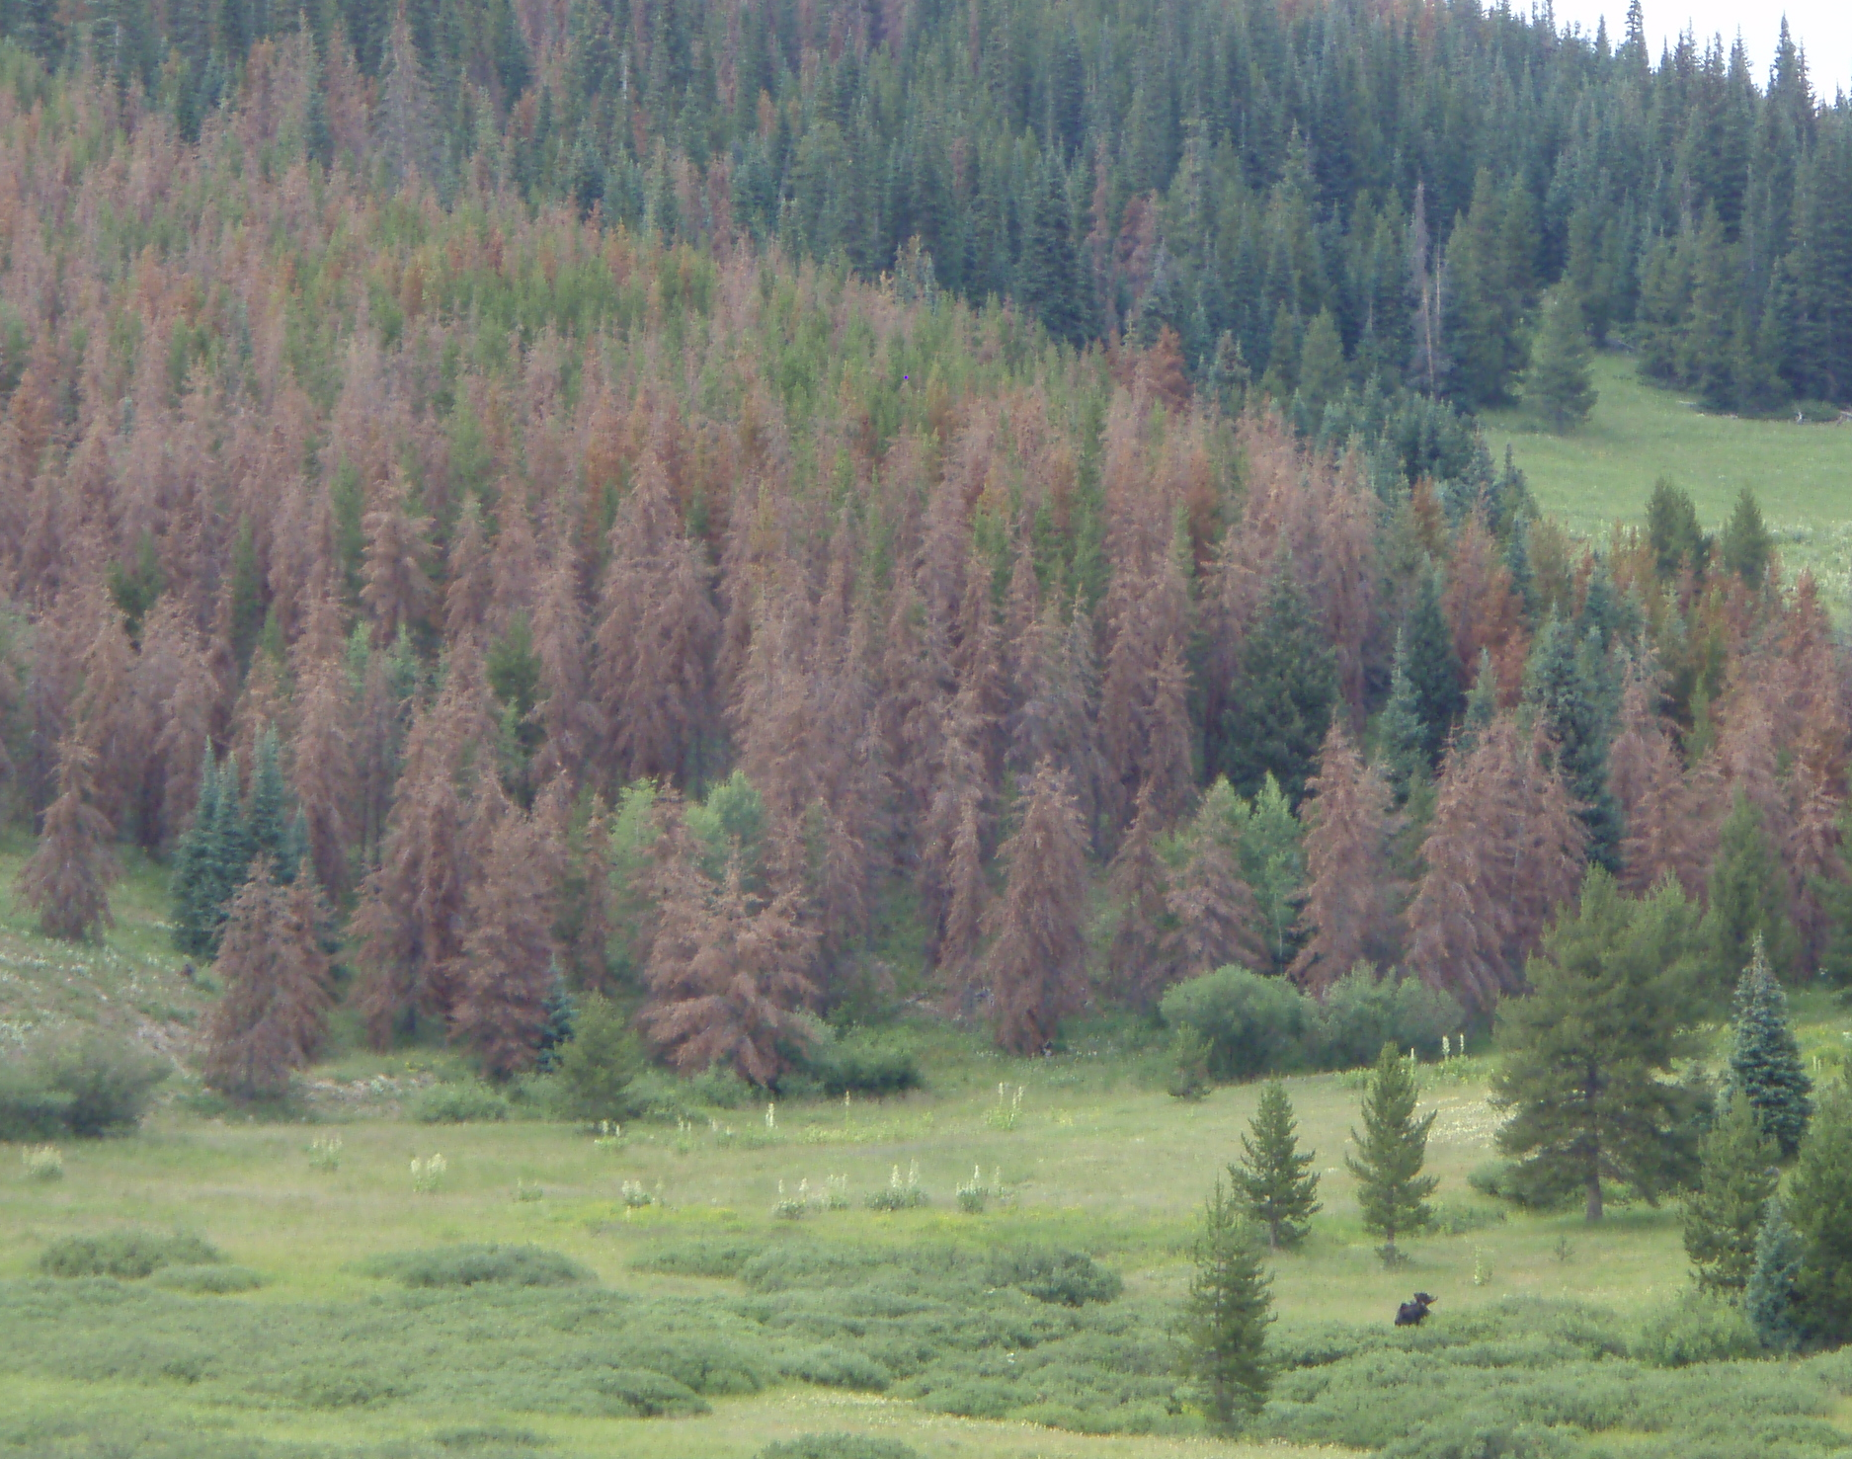
Seed Viable for Decades in Live, Serotinous Cones
(50-70 yrs; Clements 1910)
Shortly after MPB?
Germination Rate (%)
Key Findings:
Germination declined w/ cone age:
~70-30%
No difference between cones on live & dead trees
Early post-MPB period at RMNP
within 3 yrs of infestation
Conclusion:
Regeneration during initial years after MPB was limited by seed viability.
Aoki et al. 2011. Am Midl Nat
Notes:
Aoki, C.F., W.H. Romme, and M.E. Rocca. 2011. Lodgepole Pine Seed Germination Following Tree Death from Mountain Pine Beetle Attack in Colorado, USA. The American Midland Naturalist 165:446-451.
Trees known to retain cones for 40 years or longer (assume live trees), and the canopy seed bank may contain millions of seeds / ha
Seeds in serotinous cones may remain viable for up to 50-70 years.

Slide 7
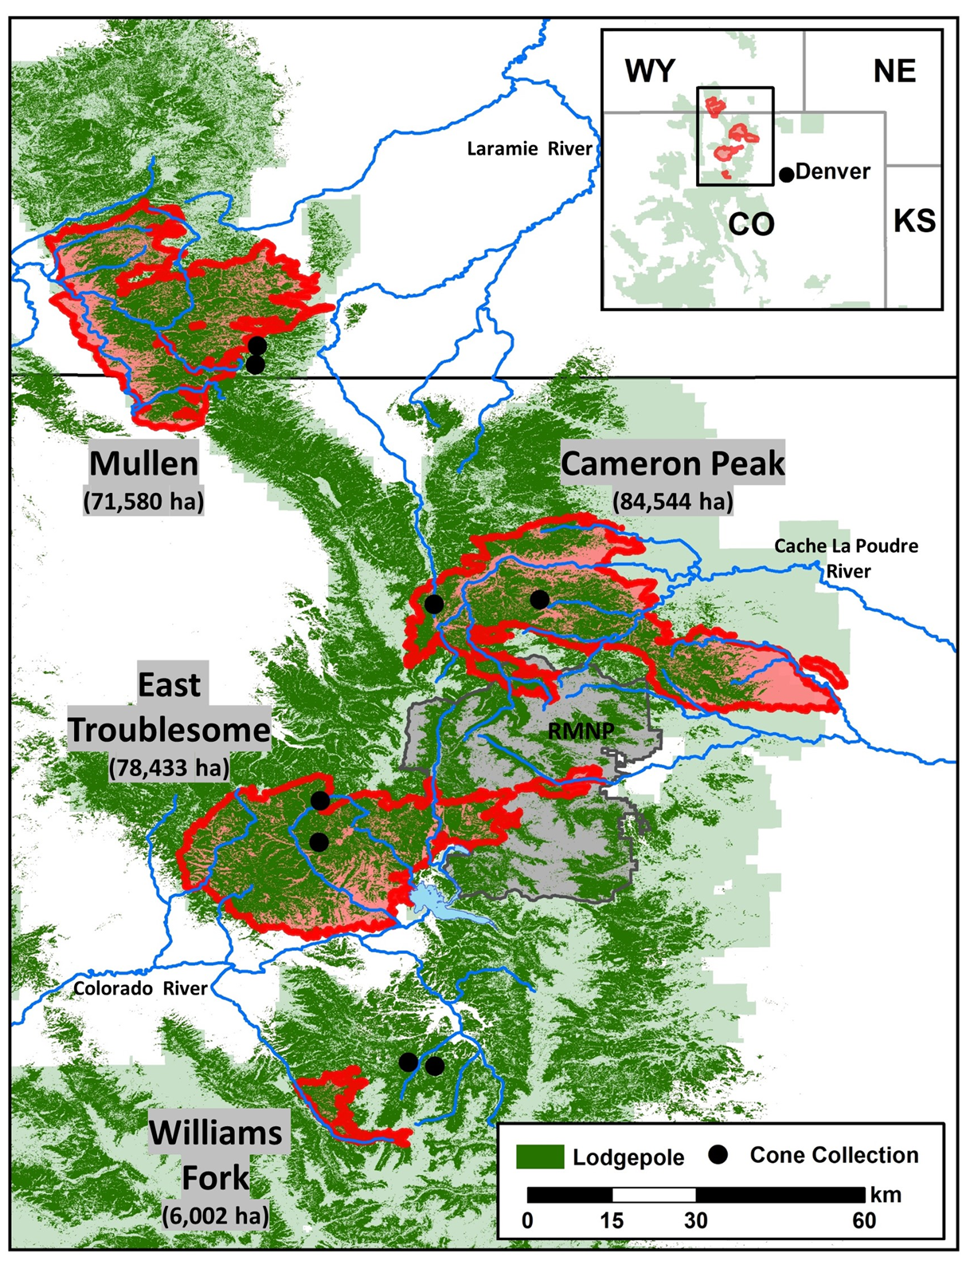
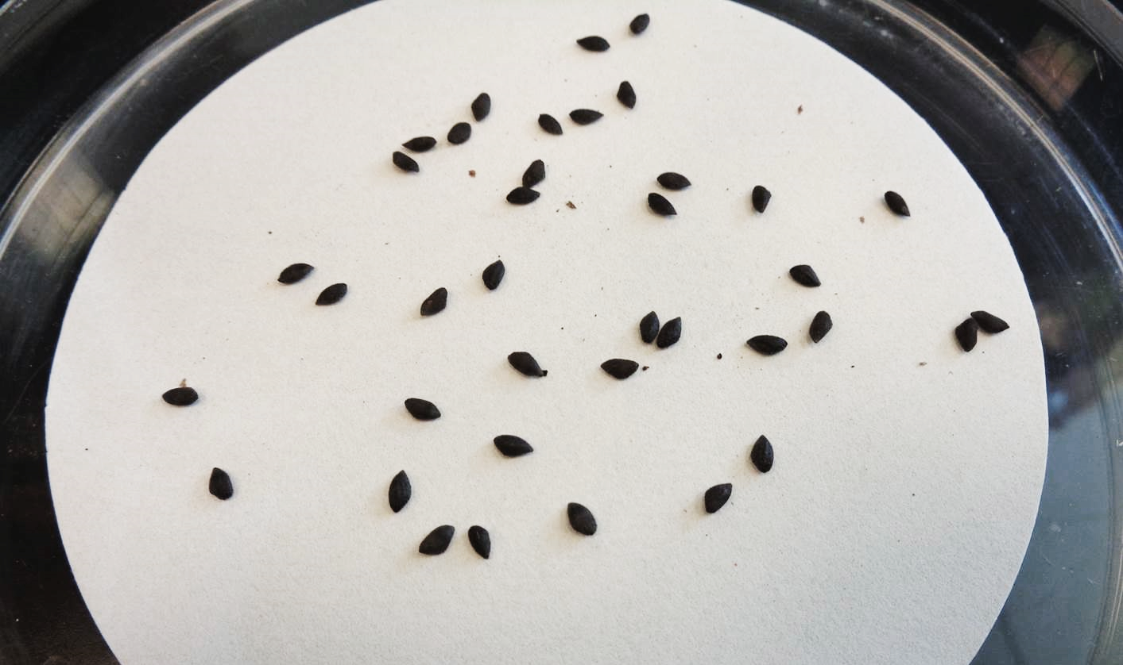
.. & Long-After MPB?
Seed Viability in Serotinous grey-Phase Forests
Sample Design
  4 gray-phase fires (2020)
  8 unburned stands, 15 yrs post-MPB
  10 serotinous trees/stand; 10 branches/tree
  Age Relation: 4000 cone-branch units
  Germination: 1000 cones in 3 age classes
Notes:
How many trees and cones total?
Wetted for 14 to 21 days
Checked daily
Germinants removed
Soaking and heating treatment
Float and check for sound embroy

Slide 8
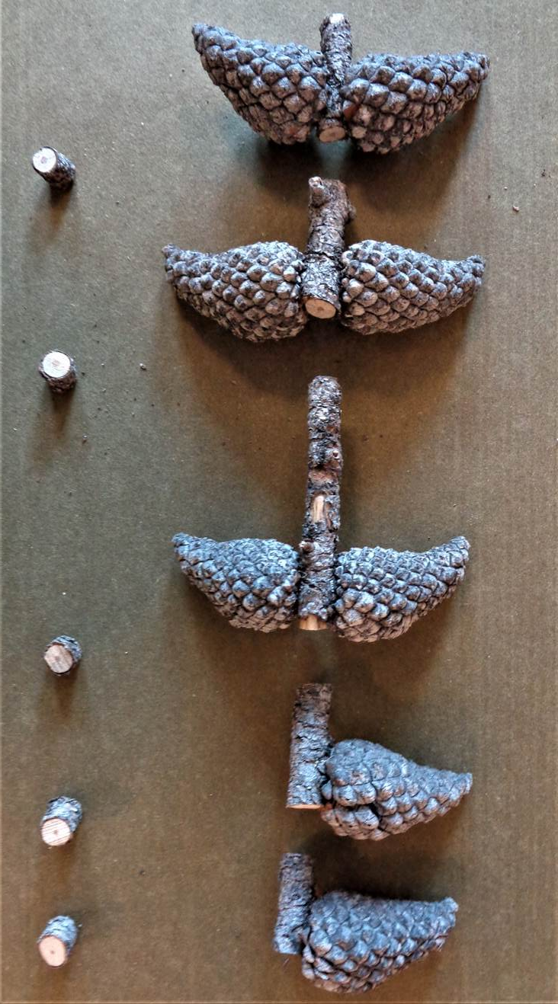
Seed Germination – Gray-Phase Trees
Germination declined with cone age: 40 - 20% for youngest to oldest cones
& so did viable seed production: 3.5 – 1.8 viable seeds per cone
(17-25 yrs vs. > 45 yrs during the 2020 fires)
Older cones more likely to contain no viable seed (35% vs 24% in younger cones).
Take Home: Seed germination from long-dead MPB cones << live trees (34 vs 70-90%).
Notes:
Overall averages
34%, cones produced 3 seeds each
Controls on opening
Dry cones
Germination and seed production is higher in younger cones
Consistent trend across sites, except where they were generally even for young cones

Slide 9
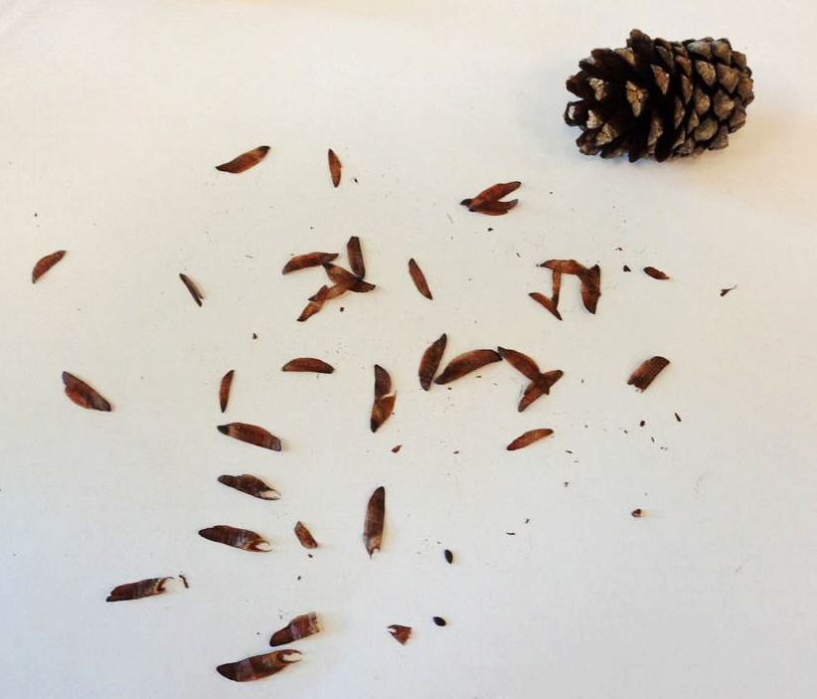
Viable Seed From the Canopy Seedbank
*Koch 1995; Lodgepole pine in N. Am.
On Poor Sites: Canopy seed produce < 30% and 10% of threshold density and pre-fire baseline density.
Notes:
1-1.5 million germinants / ha

Slide 10
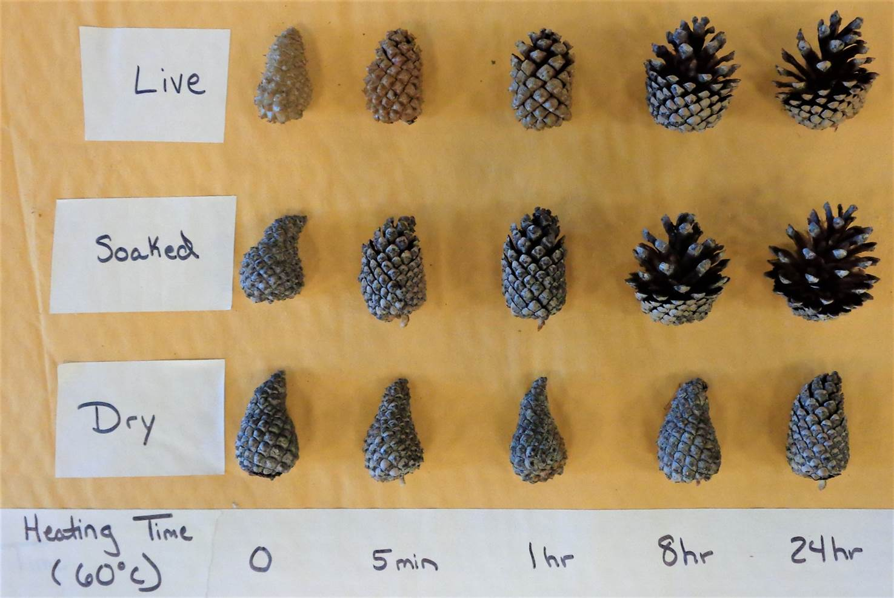
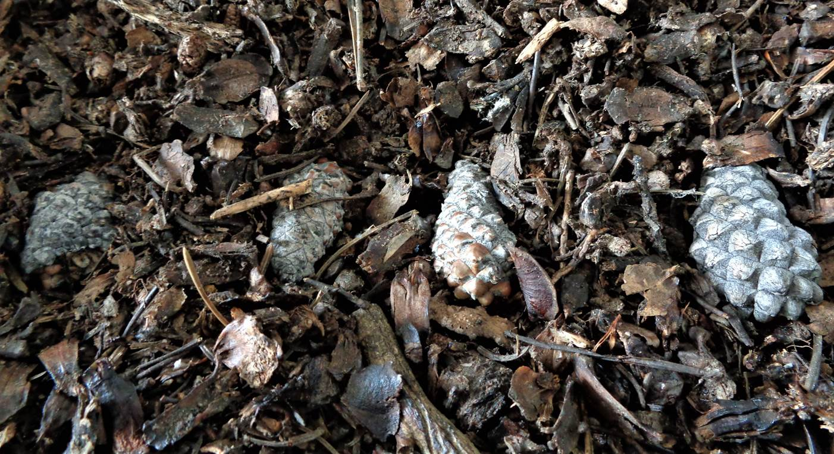
Serotinous Cones Open when Heated (typically!)
45-60 ºC (Clements 1910; Knapp & Anderson1979)
Cone Moisture Content
Live: 11%
Soaked: 54%
Dry: 5%
Cones from
MPB
Trees
Soil seedbank cones:
Buried 6 months under snowpack
60-70% moisture
36% Germination across sites
Notes:
Temps break resinous bonds that hold the cone scales close.
In absence of fire those temps are not reached in tree canopies.
Buried seed has 60% moisture

Slide 11
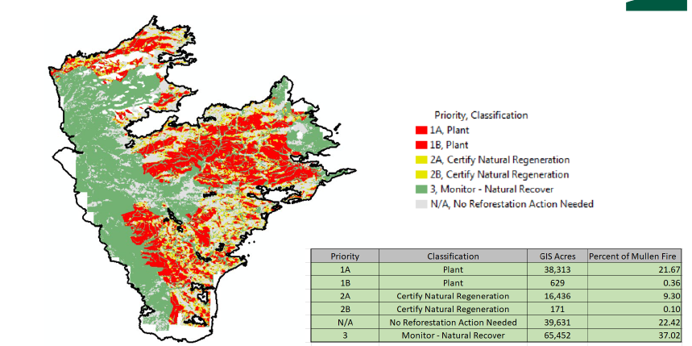
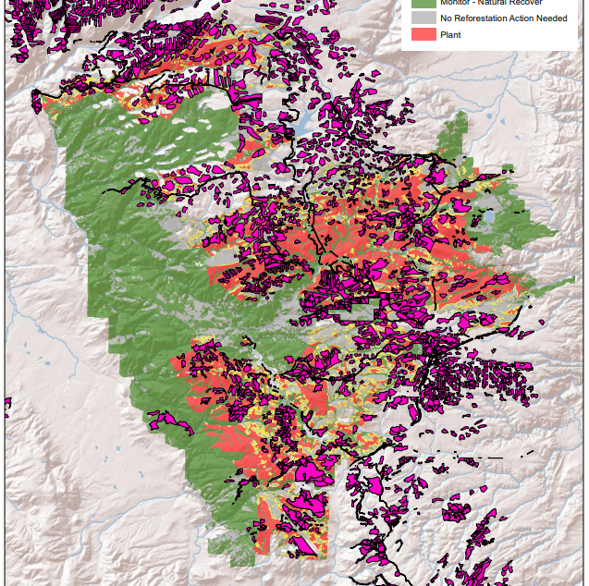
Post-Fire Regeneration From the Ground Up
Overall Goal: Inform post-fire planting priorities
Field validate GIS reforestation needs inventory
Target LPP: dominant forest type on Mullen, ET
Consider stand age, historic management
Which stand, site factors best relate to regeneration?
(fire behavior, cone abundance, ground cover)
Mullen Fire
Candidates for Planting
(24% of fire; 89% is LPP)
 | Mullen | MBR NF
 | Acres
Total | 160,632 | 353,161
Plant | 38,942 | 56,231
 | Total | Plant
 | Acres
LPP Forests | 91,743 | 34,527 (30%)
Clear Cuts | 16,711 | 6,663 (40%)
  Candidates for Planting
  75% BA Loss (Hi Severity RAVG)
  Buffered from seed source
  (forest w/ low-mod BA loss)
Mullen Fire
Historic clear cuts (43% of plant area)
R2 & MBR NF Contacts:
A. Gonzalez, M. Lowell, C. Schneider
Notes:
For the reforestation needs assessment, the BA mortality is grouped into these categories:
75% and greater BA Mortality (High Severity)
Less than 75% BA Mortality (Low & Moderate Severity).
7. 200 feet from a live seed source was simulated by applying A 200 foot buffer to polygons
bordering a tree cover typed stand with low to moderate BA loss (less than 75%).
8. MBR Forest Plan Land Suitability categories of suitable and unsuitable are applied.
9. Slope is categorized into 40% and less or greater than 40%.

Slide 12
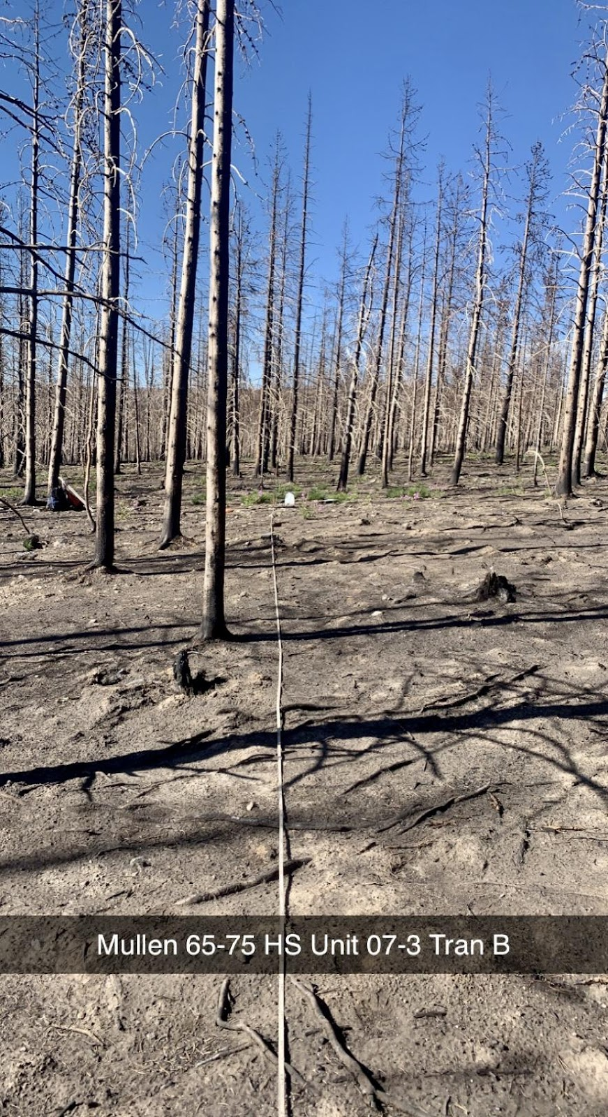
Recruit Density & Stocking - Yr 2 Post-Fire Mullen
75%
No recruits
42%
No recruits
25%
No recruits
17%
No recruits
USFS Certification: Units are ‘fully stocked’ trees are present in > 70% of plots.
None of the 48 stand-scale units were stocked
Notes:
Worst conditions in recent cuts
Highest densities, and closest to certification in Old forest
Regen stands are intermediate
(similar patterns in ET)
This is the % of the 12 quadrats that were stocked per unit (unit = stand)
Threshold is 70% to call something stocked.
144 quadrats per age
576 total quadrats
The density of lodgepole pine recruits (< 15 cm height) tallied during 2022 in reforestation candidate areas of the 2020 Mullen fire. Sampling occurred within nine 60 m2 belt transects within twelve study units per age class. Units were classified as unstocked if median density was < 370 t/ha (150 t/ac).

Slide 13
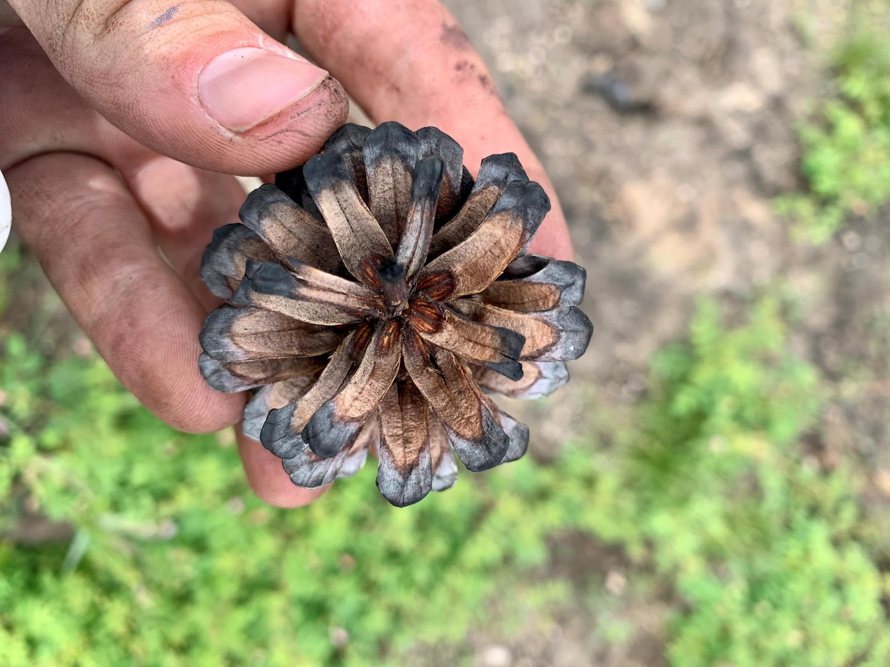
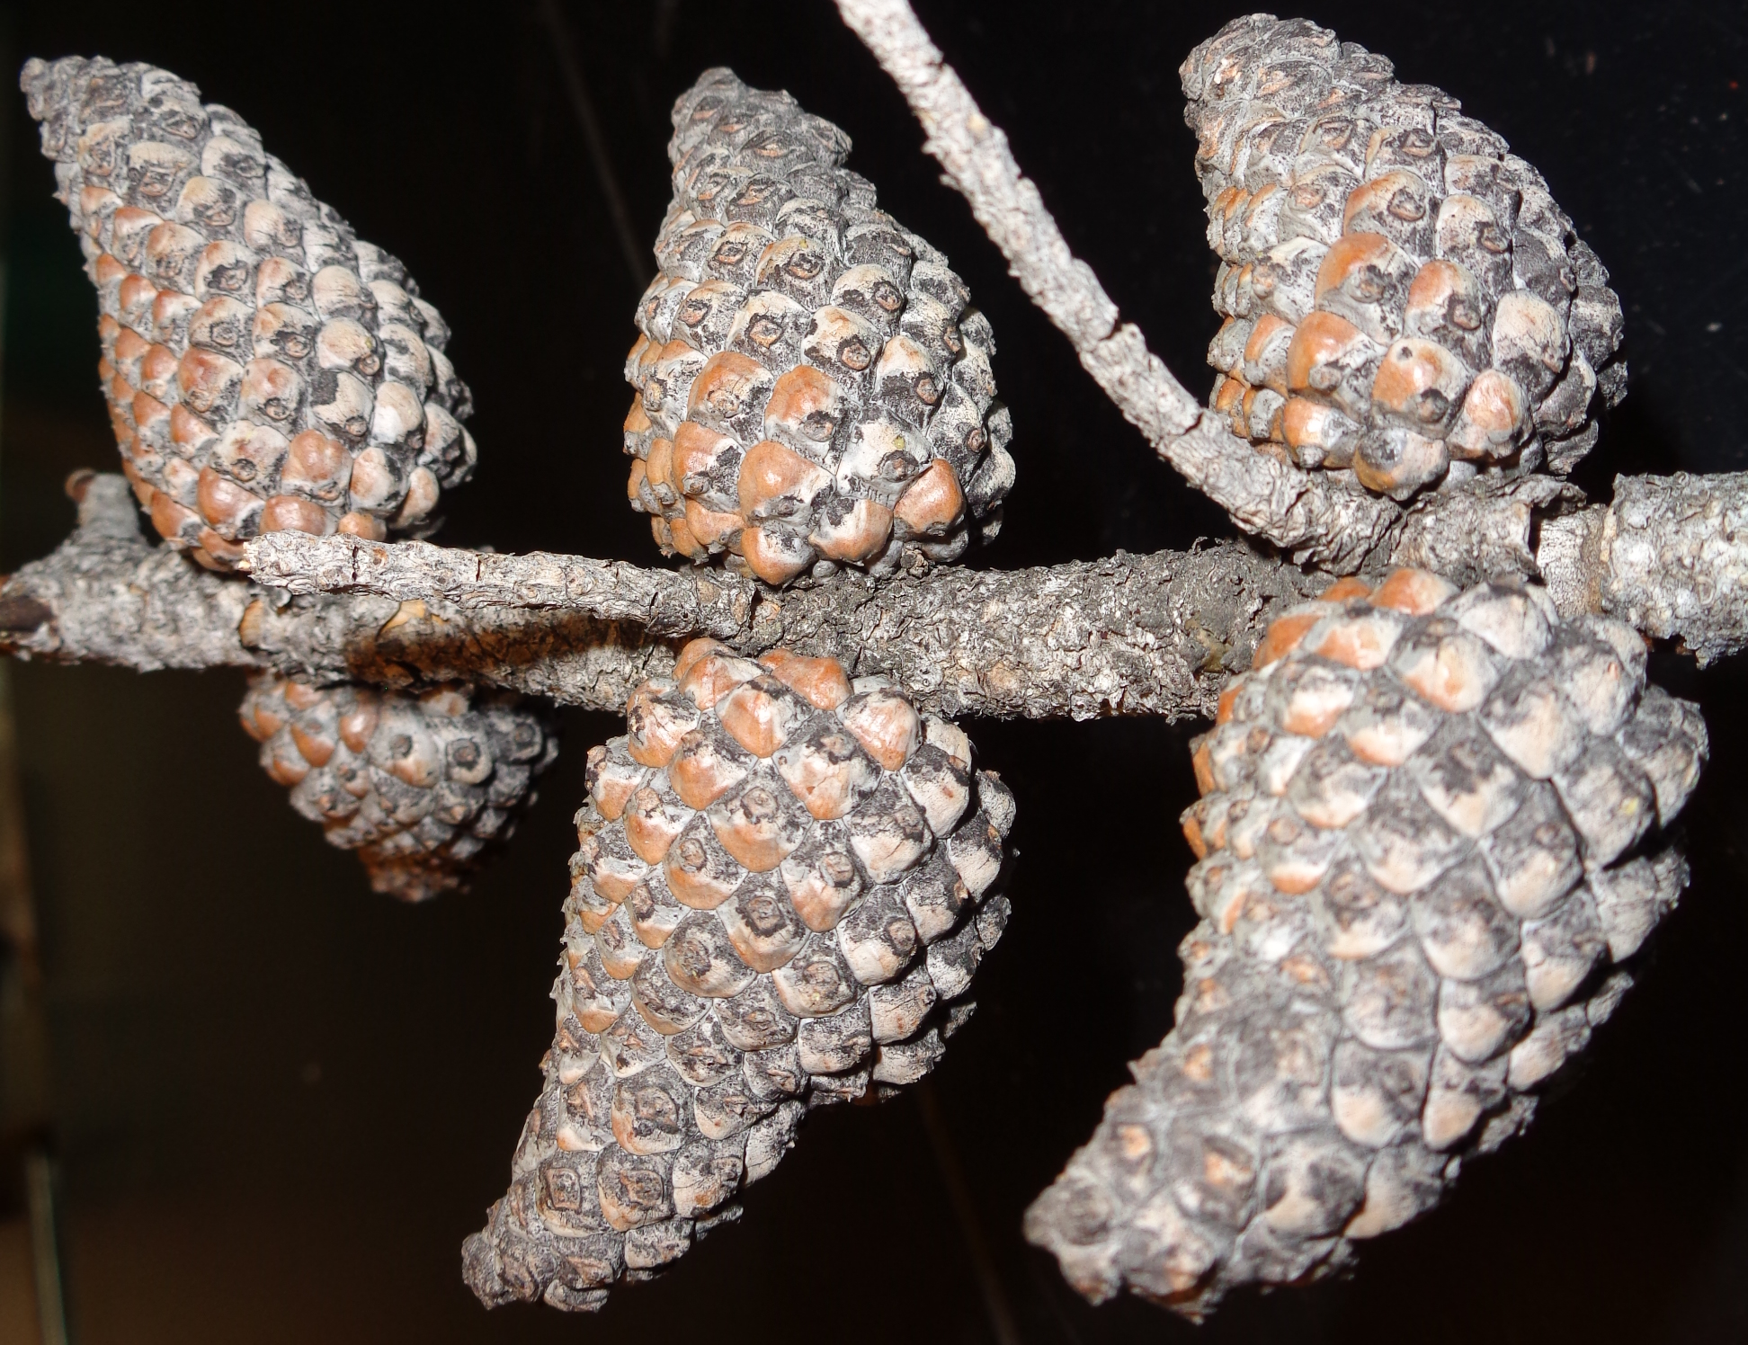
Cone Abundance & Condition
Recent Cuts:
Few trees or cones (no surprise)
Burned Regen & Forest Stands:
V. few closed cones (no surprise)
Open Cones:
Most trees have < 100 cones/tree
40-60% of trees in Regen, matrix forest
Unburned Stands:
Low density, cone shed after MPB
65% of trees have open cones
38% have closed (serotinous)
Notes:
Closed = serotinous…??
Mixed serotiny
Most trees of
Cone losses breakage from MPB trees - > 50% during first decade of MPB,

Slide 14
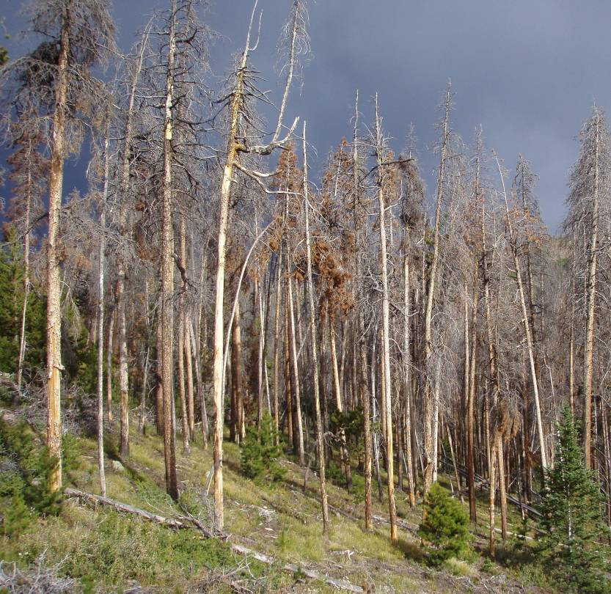
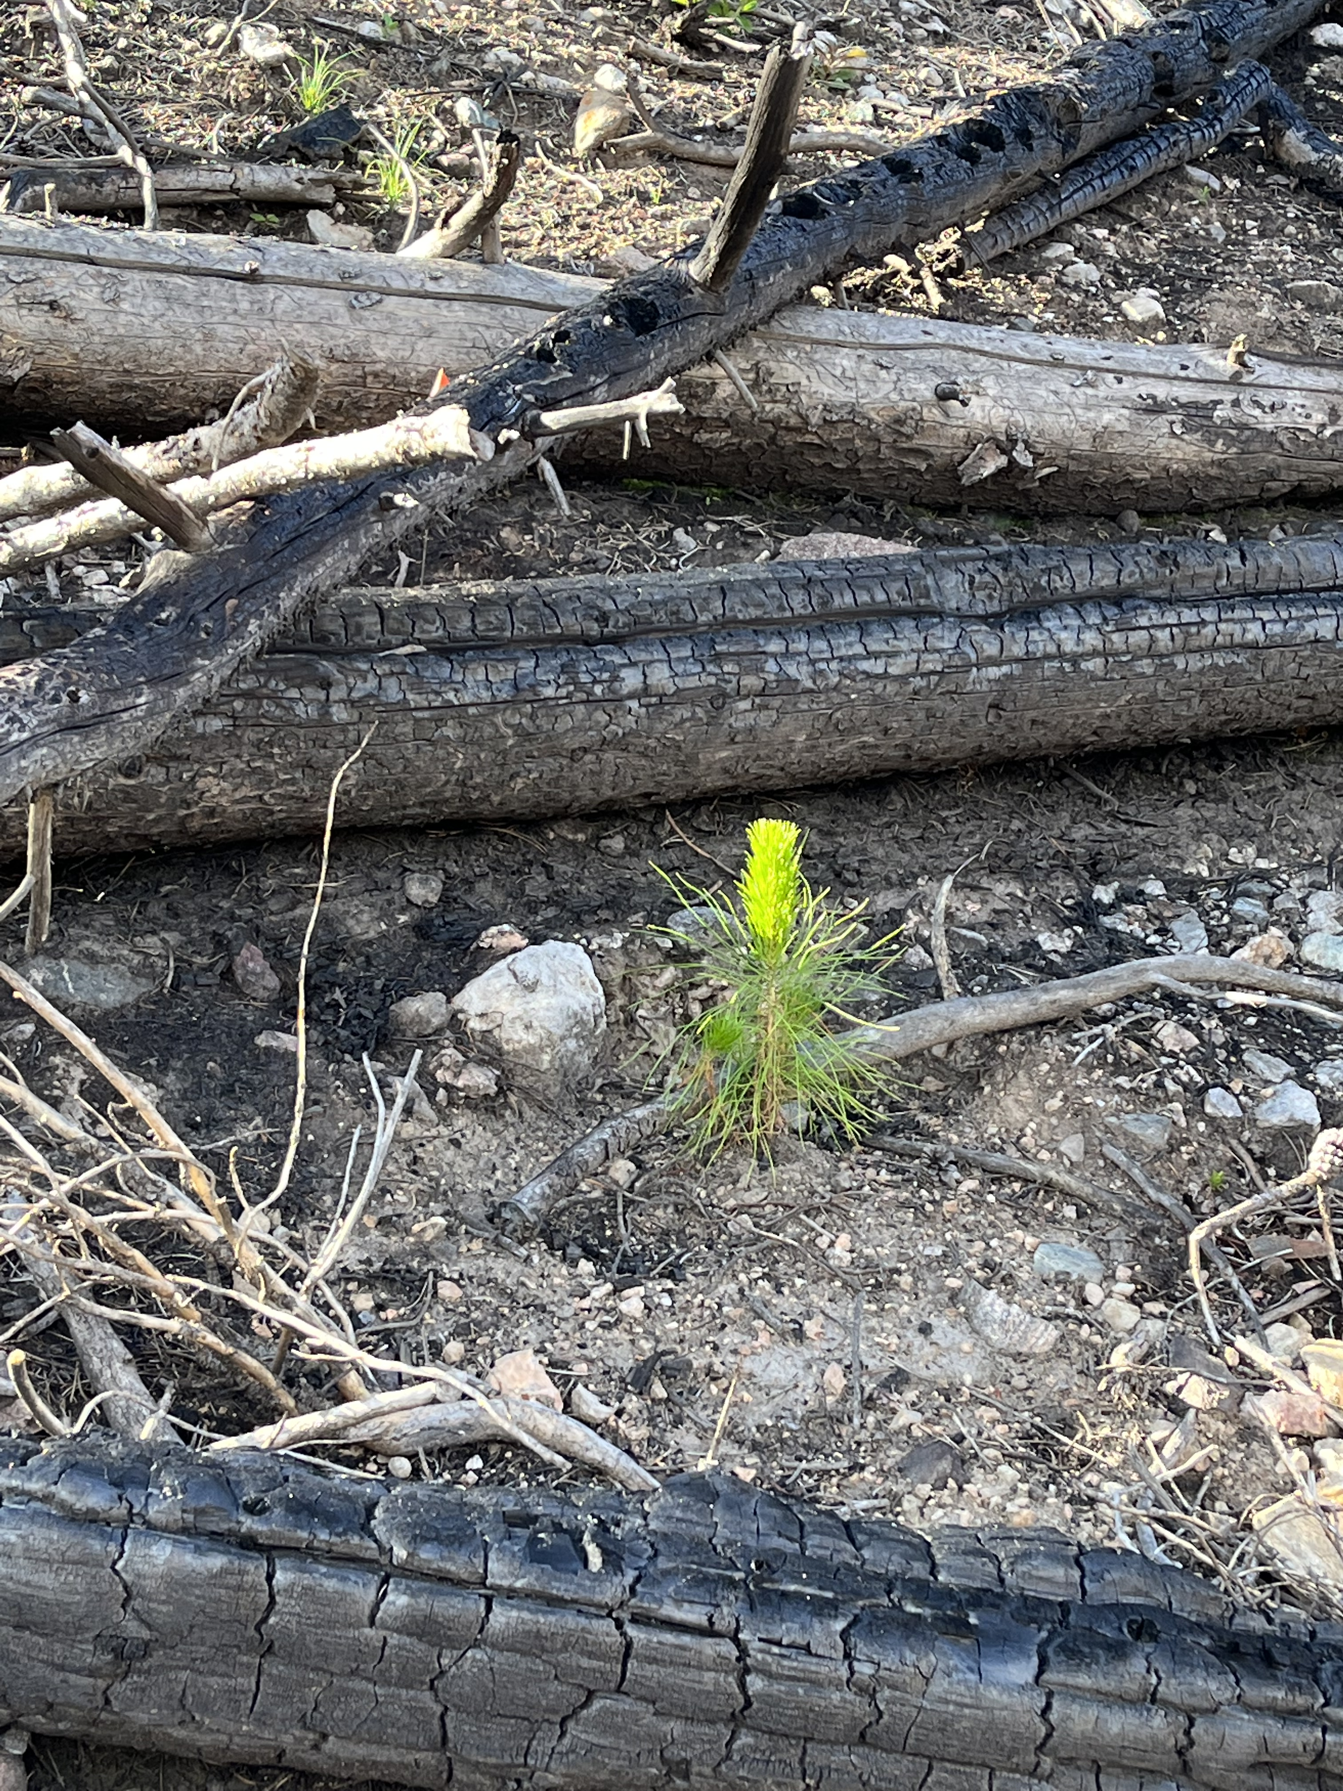
A Few Take Homes .. Po’ contorta?
Seed viability from serotinous cones on the long-dead trees was low compared to live, or recently killed trees. It is likely that low seed viability will reduce post-fire tree regeneration in some areas.
Residual live trees and cones transferred to the soil seedbank will be sources of seed to support post-fire tree regeneration.
Areas of Concern – based on seed study & Yr2 inventory
  Recent harvest units (low recruit density; low cones; serotiny)
  Gray phase stands (reduced viability, cone consumption)
Next Steps
Resample 2020 (Mullen, ET), older burns (Beaver, Ryan, Badger)
Serotiny, seed viability x stand age
Watershed restoration tree planting (Williams Fork fire)
Notes:
Blues for a Stoic Species?
Serotinous cones are a long-term bank of seed to support post-fire tree recovery, but the viability of pine seed in long-dead trees is uncertain.
pine seed in long-dead trees is uncertain.
Seed viability from serotinous cones on the long-dead trees was low compared to live, or recently killed trees.
Seed germination declined from about 40% for cones 17-25 years old at the time of the 2020 fires to <20% for cones > 45 years old.
Residual live trees and cones transferred to the soil seedbank are sources of seed to support post-fire tree regeneration.

Slide 15
Thanks!
Chuck Rhoades – US Forest Service
Rocky Mountain Research Station
Gratefully Acknowledge Support From:
RMRS, Medicine Bow-Routt NF, CFRI
For Details: Rhoades, et al. 2022. For Ecol & Mgmt
Vol 526, 120565
Notes:
Rhoades, C. C., Fegel, T. S., Hubbard, R. M., & Chambers, M. E. (2022). Limited seed viability in long-dead serotinous lodgepole pine trees: Implications for post-fire tree regeneration after bark beetle infestations. For Ecol & Mgmt, 526, 120565.

